Slide 1
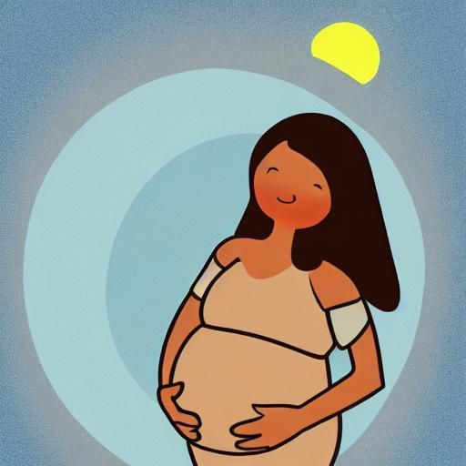



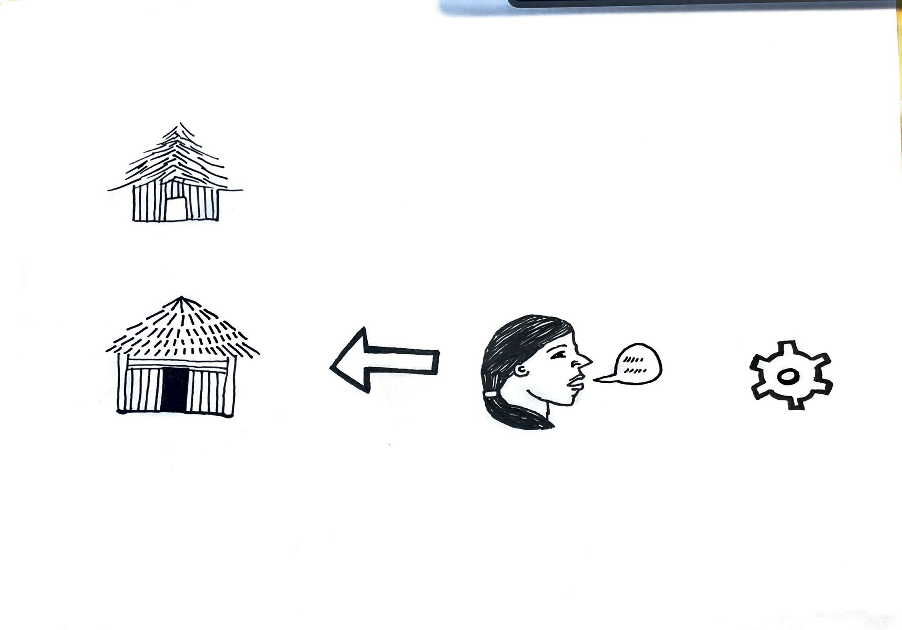
Luna
Health for the Whole Family
How to use this app
Start learning
Notes:
- Framework developed from WHO guidelines and adapted for CNB Panama context:
9789241549912-eng.pdf (who.int)
- All images are public domain/creative commons, source is noted
Image source
Nightcafe
2,3. Pixabay

Slide 2



How to use this app
Touch a picture to see more information
Touch the arrow to return to the previous page
Touch the words to hear them read aloud
Touch the house to return to the beginning
Notes:
- Framework developed from WHO guidelines and adapted for CNB Panama context:
9789241549912-eng.pdf (who.int)
- All images are public domain/creative commons, source is noted
Image source
Nightcafe
2,3. Pixabay
https://images.app.goo.gl/yS13rUmjDe4RtY1X9
https://images.app.goo.gl/wB8Y7nvA2KCTeAqB8

Slide 3
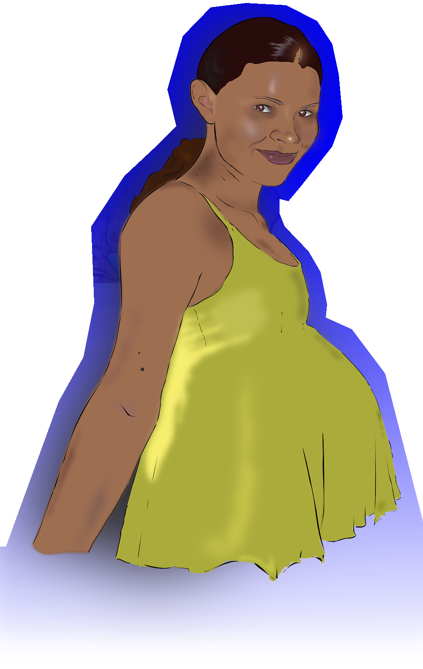

My topics
Pregnancy Health Conditions
Download
new topics
Notes:
Image source
1. Download Pregnant, Woman, Pregnancy. Royalty-Free Vector Graphic - Pixabay
2,4. Pixabay
3. Indonesia C-IYCF Counselling Cards (ptiib.s3.amazonaws.com)

Slide 4

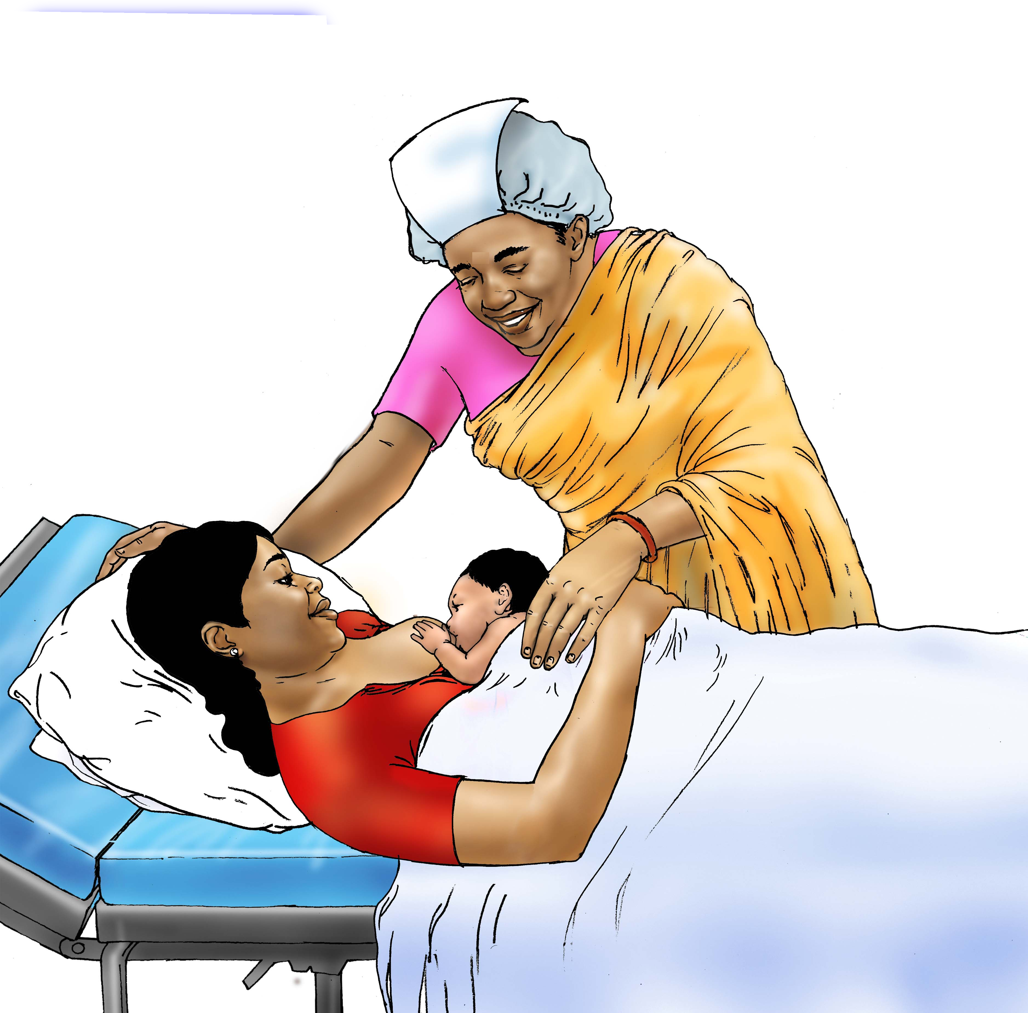
Pregnancy Health
Danger signs during pregnancy
Danger signs after birth
Notes:
Image source 1. Pixabay
2. Family Planning - Female sterilization - 08 - Non-country specific | IYCF Image Bank (advancingnutrition.org)
3. Download Connect Competition Pregnant Woman Royalty-Free Stock Illustration Image - Pixabay
4. Download Vegetables, Fruits, Food. Royalty-Free Vector Graphic – Pixabay
5. Breastfeeding - Early initiation of breastfeeding 0-6 mo - 02 - India | IYCF Image Bank (advancingnutrition.org)
6. Family Planning - Birth Control - condom - 03 - Nepal | IYCF Image Bank (advancingnutrition.org)
Family Planning - Injectable contraceptives - 03 - Kyrgyz Republic | IYCF Image Bank (advancingnutrition.org)

Slide 5
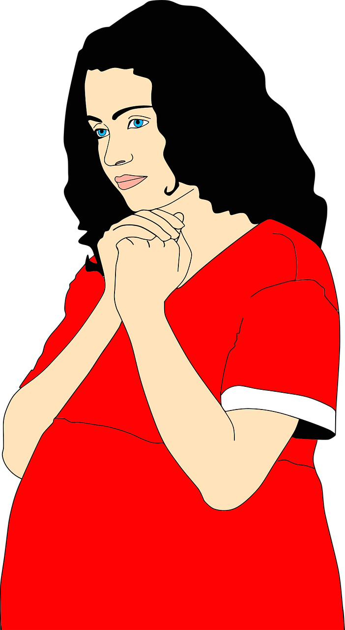


Dangerous symptoms during pregnancy
Dangerous conditions during pregnancy
Notes:
Image source
Download Ambulance, Automobile, Rescue Service. Royalty-Free Vector Graphic – Pixabay
Download Doctor Female Doctor Secretary Royalty-Free Stock Illustration Image – Pixabay
Download Birth, Child, Faith. Royalty-Free Vector Graphic - Pixabay

Slide 6
Dangerous symptoms after birth
Dangerous conditions after birth
Notes:
Image source
Download Ambulance, Automobile, Rescue Service. Royalty-Free Vector Graphic – Pixabay
Download Doctor Female Doctor Secretary Royalty-Free Stock Illustration Image – Pixabay
Download Birth, Child, Faith. Royalty-Free Vector Graphic - Pixabay

Slide 7


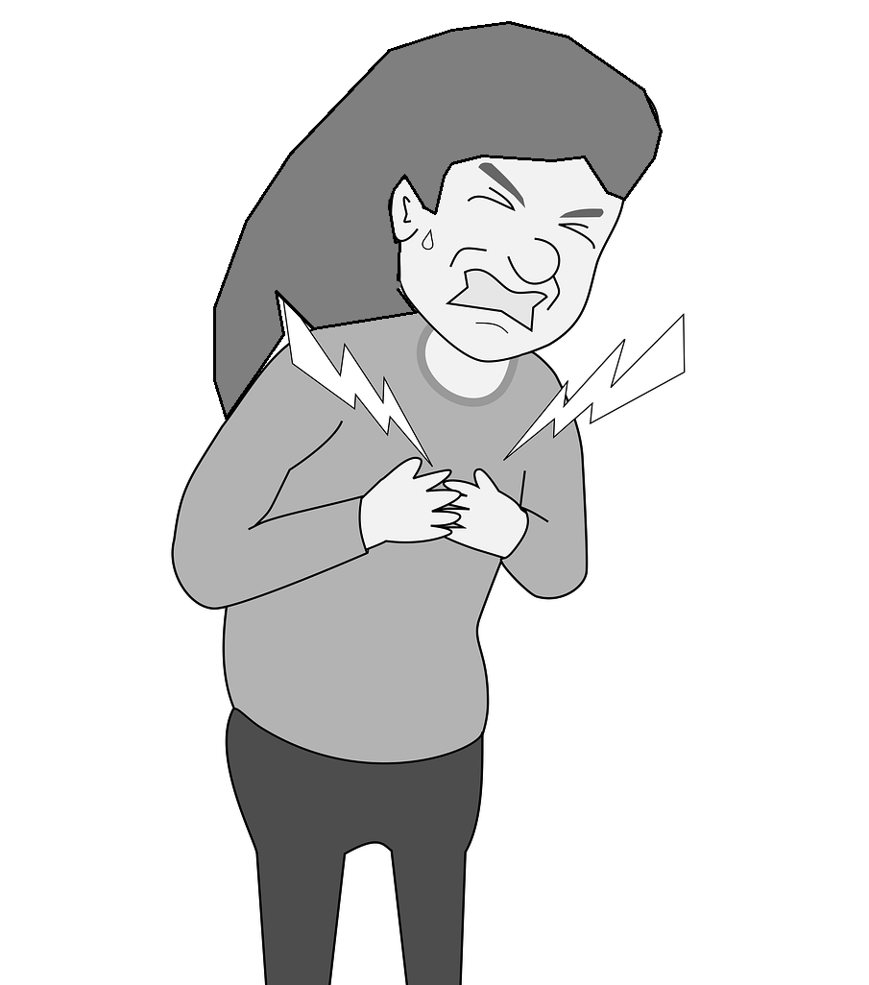
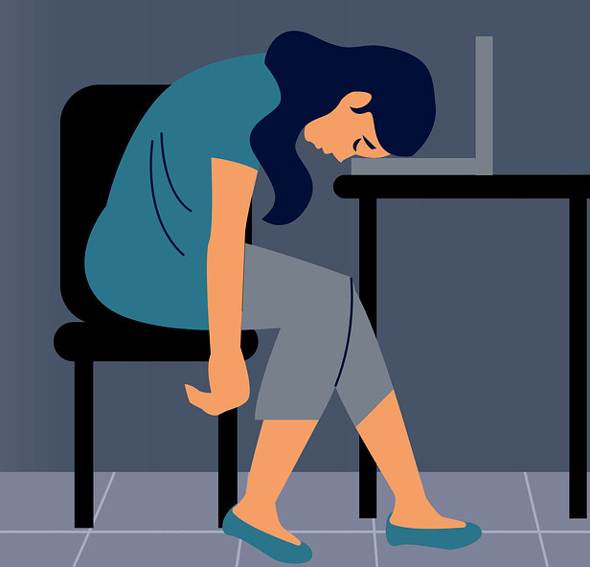

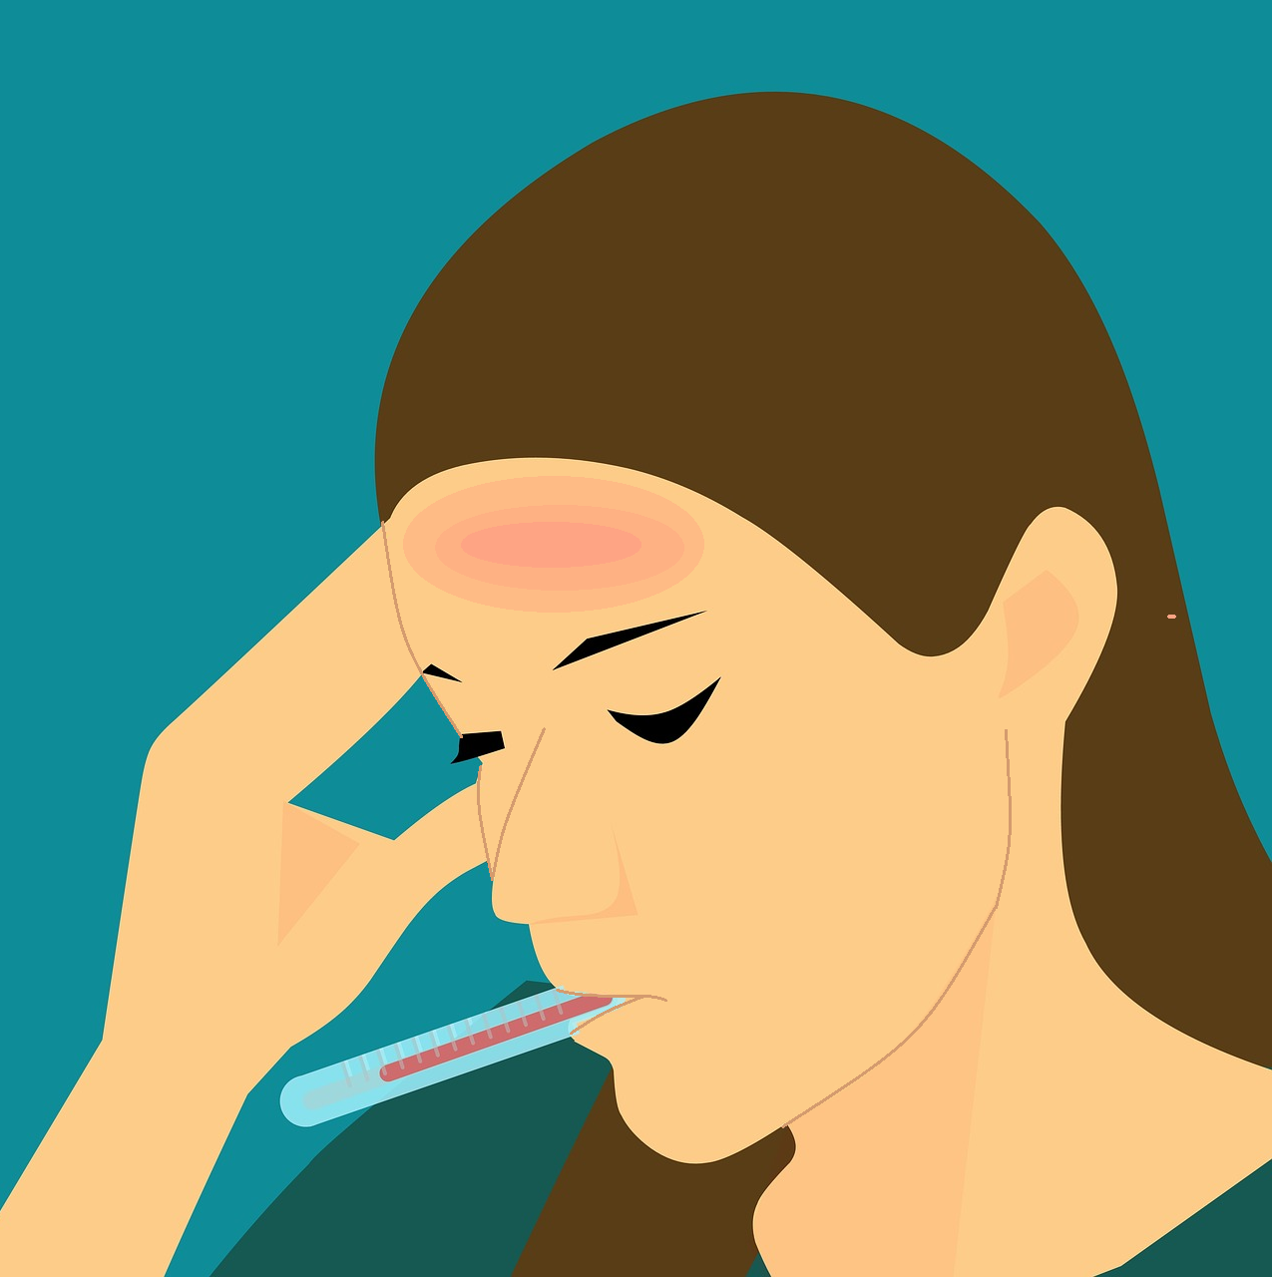

Go to emergency TODAY if you have any of these symptoms
Severe headache
Trouble breathing
Can’t stay awake
Chest pain
Dizziness or fainting
Fever
MORE SYMPTOMS
Notes:
Info source:
Urgent Maternal Warning Signs | AIM (saferbirth.org)
Image source:
Download Arrows, Right, Next. Royalty-Free Vector Graphic – Pixabay
Download Headache Woman Sad Royalty-Free Stock Illustration Image – Pixabay
Download Symptoms Icons Person Royalty-Free Stock Illustration Image – Pixabay
Download Fatigue Work Work From Home Royalty-Free Stock Illustration Image – Pixabay
Download Heart Attack Pain Man Royalty-Free Stock Illustration Image - Pixabay
Download Loss Of Balance Dizziness Drunk Royalty-Free Stock Illustration Image – Pixabay
Download Fever Sick Cold Royalty-Free Stock Illustration Image - Pixabay

Slide 8
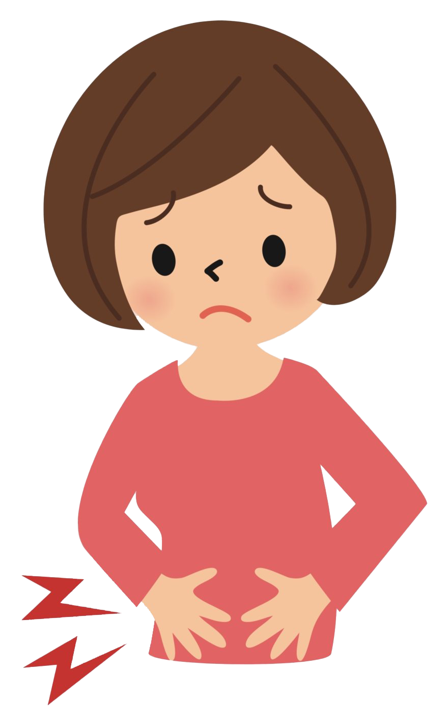




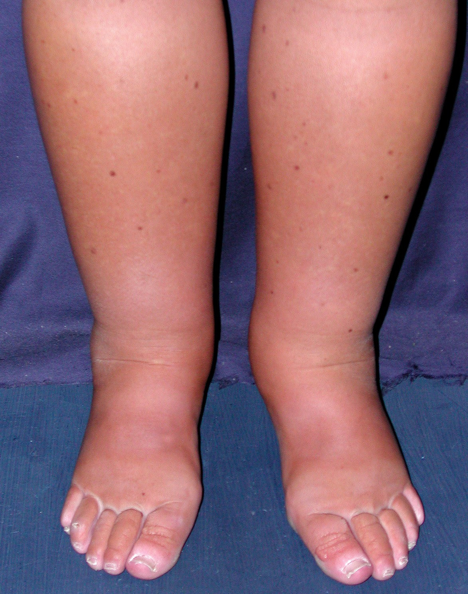

Go to emergency TODAY if you have any of these symptoms
Severe stomach pain
Severe nausea
Baby stops moving
Bleeding from vagina
Severe swelling
Changes in vision
MORE SYMPTOMS
Notes:
Pop up boxes appear if any of the images are clicked
Info source:
Urgent Maternal Warning Signs | AIM (saferbirth.org)
Image source:
https://www.pngall.com/stomach-ache-png/
https://s3-us-west-2.amazonaws.com/courses-images/wp-content/uploads/sites/5351/2020/07/15233245/nausea-vomiting-clipart-lg-807x1024.png
Download Birth, Child, Female. Royalty-Free Vector Graphic - Pixabay
Download Underwear Boxer Panties Royalty-Free Stock Illustration Image – Pixabay
https://www.wikidoc.org/index.php/Primary_Intestinal_Lymphangiectasia
https://www.tuoptometrista.com/solucion/terapia-por-insuficiencia-acomodativa/
Download Glasses, Frequency, Glasses Frame. Royalty-Free Vector Graphic - Pixabay

Slide 9
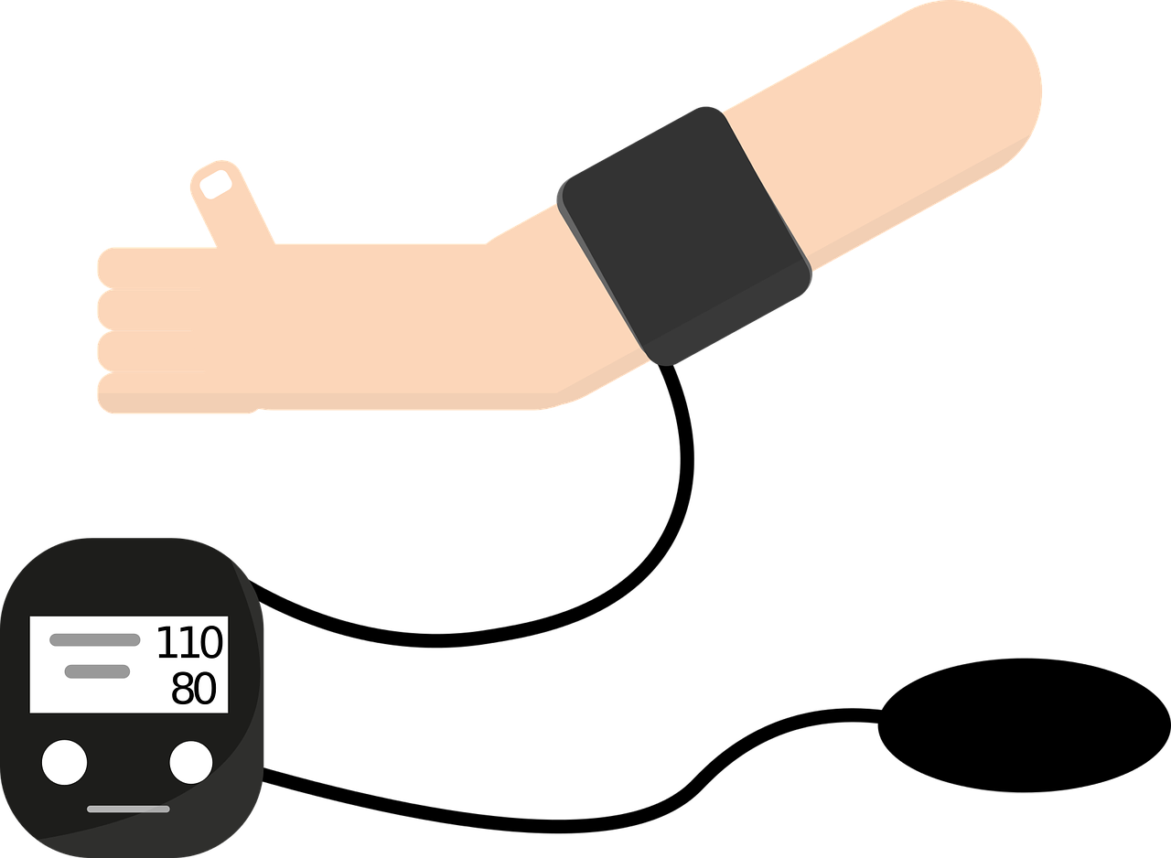
Go to emergency TODAY if you have any of these symptoms
Severe headache
A headache that started suddenly, is throbbing and above your ear, and will not go away
Watch out for: dizziness, swelling, or changed vision
This could be a sign of pre-eclampsia: dangerous high blood pressure
MORE SYMPTOMS
Notes:
Info source:
Urgent Maternal Warning Signs | AIM (saferbirth.org)
Image source:
Download Blood Pressure Measuring Machine, Blood Pressure, Health. Royalty-Free Vector Graphic - Pixabay

Slide 10


Go to emergency TODAY if you have any of these symptoms
Trouble breathing
You can’t get enough air when you breathe, or your chest or throat is tight, or you can’t breathe when you’re lying down
Watch out for: swelling, chest pain, headache, dizziness, changes in vision, or a fast heartbeat
This could be a sign of pre-eclampsia, or blood or infection in your lungs
MORE SYMPTOMS
Notes:
Info source:
Urgent Maternal Warning Signs | AIM (saferbirth.org)
Image source:
Download Bed, Hospital, Medical. Royalty-Free Vector Graphic – Pixabay

Slide 11
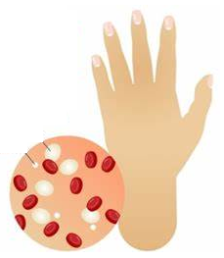
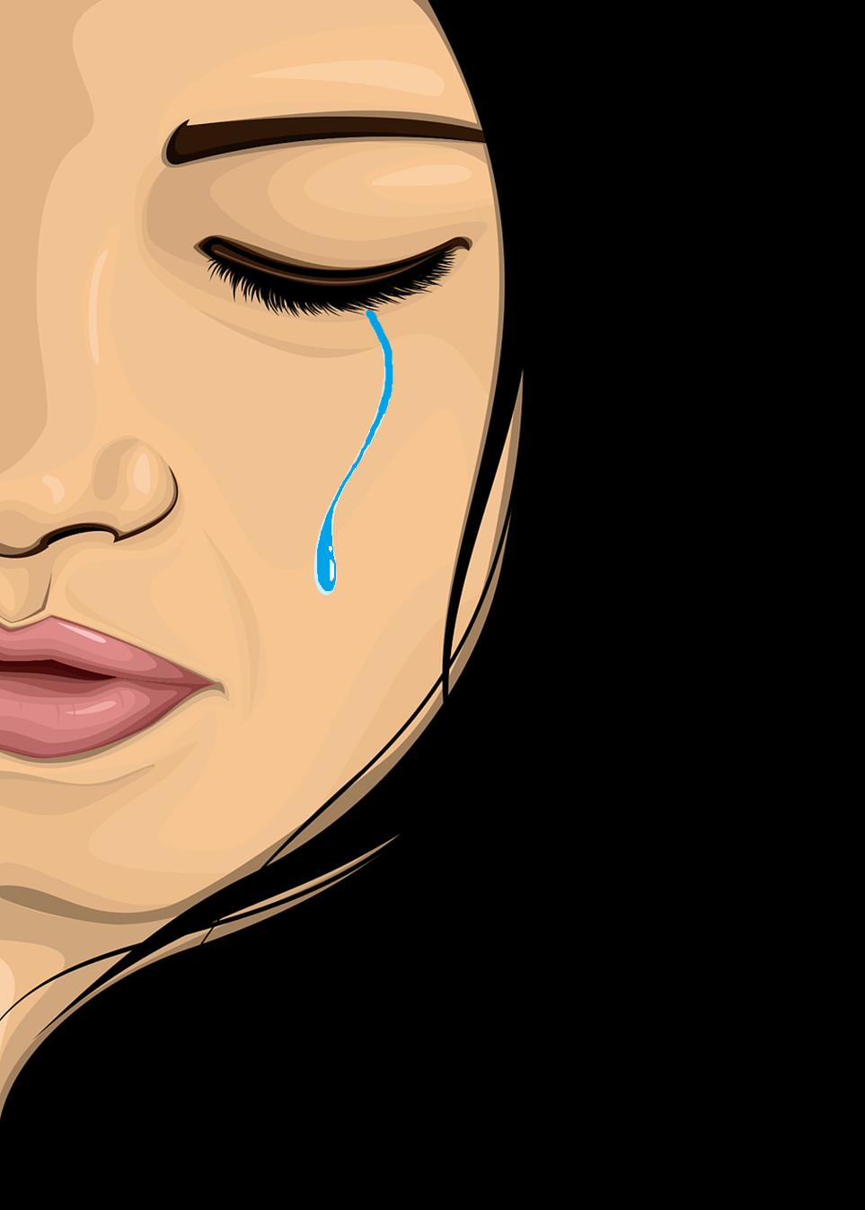
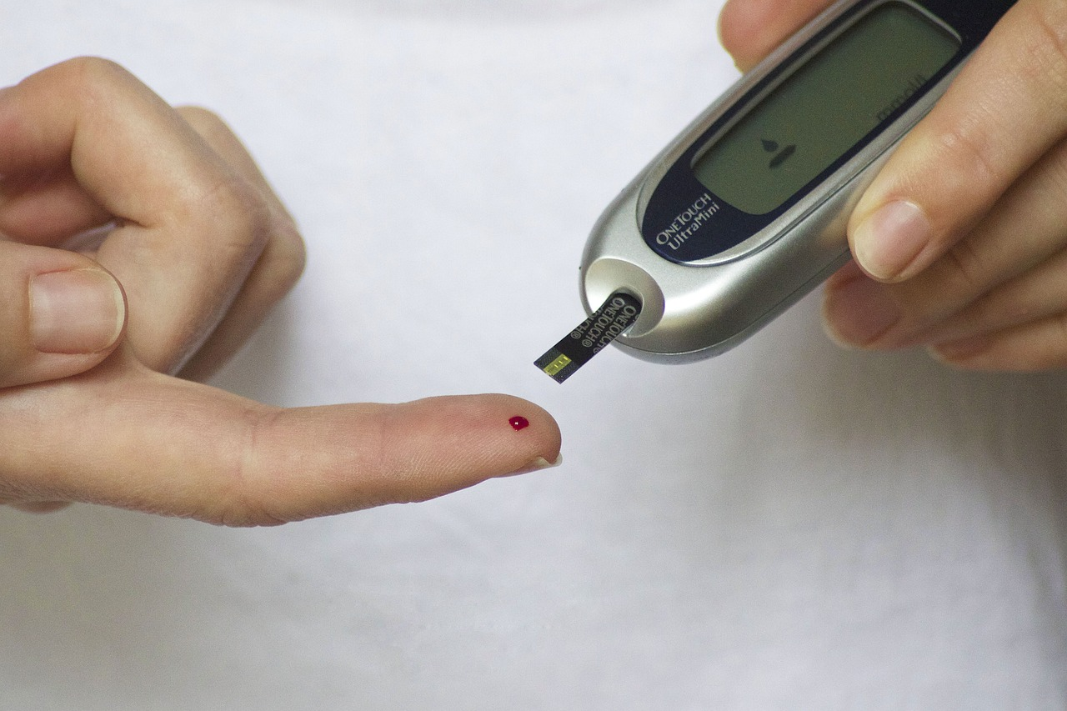
Go to emergency TODAY if you have any of these symptoms
Can’t stay awake
You are so tired or weak that you can’t do your daily tasks or take care of your children, and this continues for months
This could be a sign of heart disease, anemia, diabetes, or depression
MORE SYMPTOMS
Notes:
Info source:
Urgent Maternal Warning Signs | AIM (saferbirth.org)
Image source:
https://th.bing.com/th/id/OIF.je3BL9GtNfXJJ80ls89psw?rs=1&pid=ImgDetMain
Diabetes Blood Finger - Free photo on Pixabay – Pixabay
Download Woman, Cry, Crying. Royalty-Free Vector Graphic - Pixabay

Slide 12
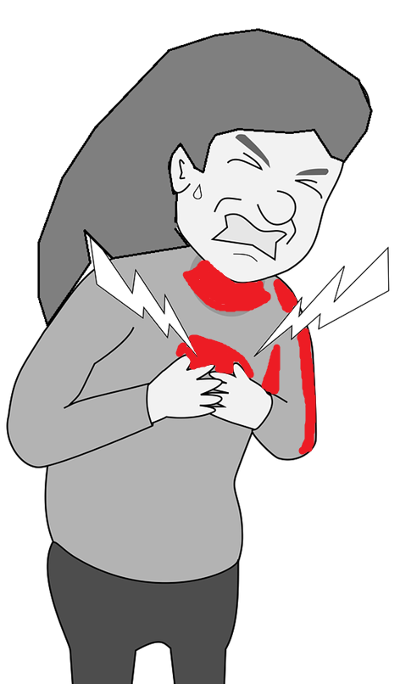
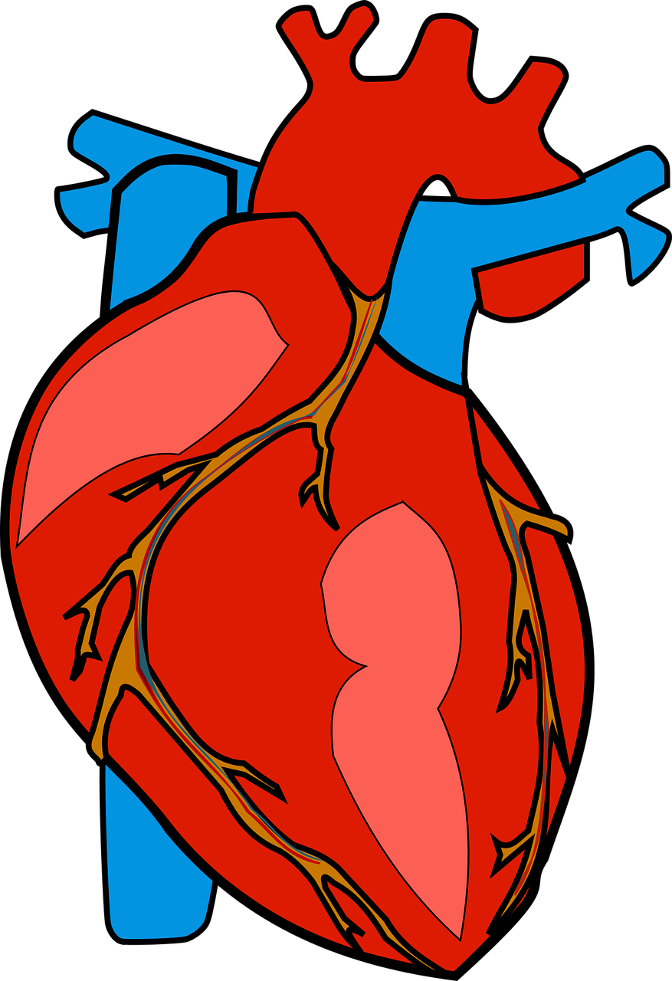
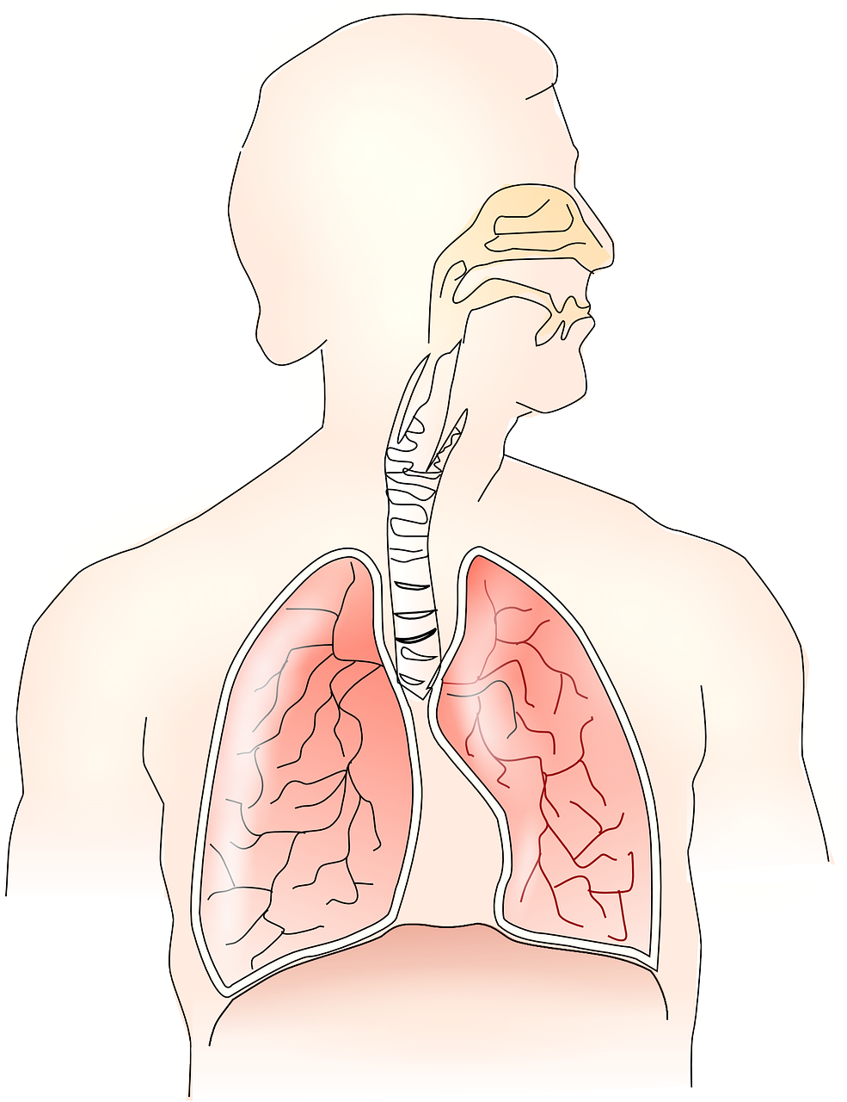
Go to emergency TODAY if you have any of these symptoms
Chest pain
Any symptom like fast or irregular heartbeat, pain that moves to your arm or neck, tightness in chest,
Watch out for: sudden onset, swelling, dizziness or confusion, trouble breathing, headache.
This could be a sign of heart attack or a blockage in your lungs
MORE SYMPTOMS
Notes:
Info source:
Urgent Maternal Warning Signs | AIM (saferbirth.org)
Image source:
Download Anatomical, Healthcare, Heart. Royalty-Free Vector Graphic – Pixabay
Download Anatomy, Lungs, Breathing. Royalty-Free Vector Graphic - Pixabay

Slide 13
Go to emergency TODAY if you have any of these symptoms
Dizziness or fainting
Dizziness that continues for days, fainting, or forgetting time
Watch out for: headache, trouble breathing, bleeding, or changes in vision
This could be a sign of pre-eclampsia, stroke, or blood sugar
MORE SYMPTOMS
Notes:
Info source:
Urgent Maternal Warning Signs | AIM (saferbirth.org)
Image source:
https://th.bing.com/th/id/R.bfafb668d1521c7ccf77d0b5524ce1d0?rik=CuLVeQjSmqTIUA&riu=http%3a%2f%2fwww.conscienciayenergia.org%2fj3%2fcp%2fimages%2fconsciencia%2fsalud%2fmareo.jpeg&ehk=y%2fDGVDpVseLvl%2fc7hKSHU05CWnnTHo%2fIPpU%2bSIULhRQ%3d&risl=&pid=ImgRaw&r=0

Slide 14
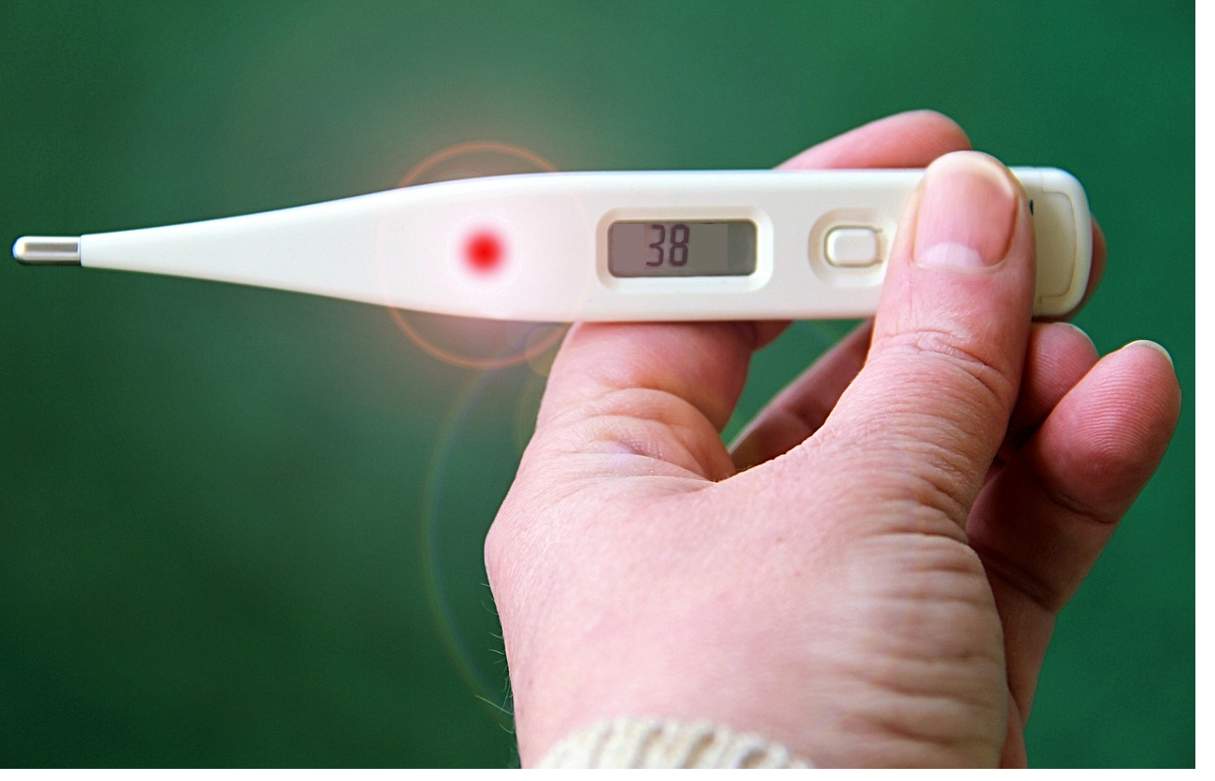
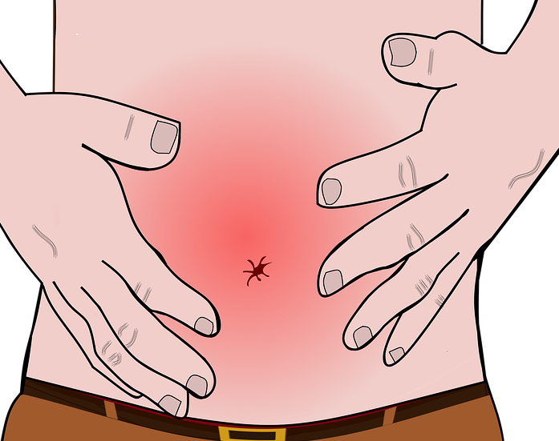
Go to emergency TODAY if you have any of these symptoms
Fever
Temperature of 38°C or higher
Watch out for: diarrhea, vomiting, pain, discharge, or trouble urinating
This could be a sign of infection inside of your body
MORE SYMPTOMS
Notes:
Info source:
Urgent Maternal Warning Signs | AIM (saferbirth.org)
Image source:
Download Belly Stomach Pain Pains Royalty-Free Stock Illustration Image – Pixabay
Thermometer Fever Number - Free photo on Pixabay - Pixabay

Slide 15
Go to emergency TODAY if you have any of these symptoms
Severe stomach pain
A sudden and severe pain in your stomach that is sharp or like period cramps
Watch out for: pain in chest, shoulder, and back, heartburn, and vaginal bleeding
This could be a sign of pre-eclampsia or a separation of the placenta from your uterus
MORE SYMPTOMS
Notes:
Info source:
Urgent Maternal Warning Signs | AIM (saferbirth.org)

Slide 16

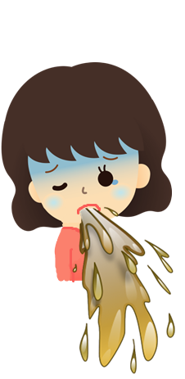

Go to emergency TODAY if you have any of these symptoms
Severe nausea
Throwing up and nausea that is not normal morning sickness, you cannot eat or drink for the whole day
Watch out for: Dry mouth, headaches, dizziness and confusion, fever
This could be a sign of a viral infection, food poisoning, or problems with your liver or pancreas
MORE SYMPTOMS
Notes:
Info source:
Urgent Maternal Warning Signs | AIM (saferbirth.org)
Image source:
Download Eject, Emit, Expel. Royalty-Free Vector Graphic – Pixabay
Download Water, Cup, Drink. Royalty-Free Vector Graphic – Pixabay
Download False, Error, Is Missing. Royalty-Free Vector Graphic - Pixabay

Slide 17
Go to emergency TODAY if you have any of these symptoms
Baby stops moving
You can feel that your baby is moving less than before, or isn’t moving at all
This could be a sign of an infection in your uterus, or a problem with the baby
MORE SYMPTOMS
Notes:
Info source:
Urgent Maternal Warning Signs | AIM (saferbirth.org)

Slide 18

Go to emergency TODAY if you have any of these symptoms
Bleeding from vagina
Bleeding that is like a period, or discharge that is bloody, green, or smells bad
Watch out for: cramps or stomach pain, light-headedness
This could be a sign of infection, the placenta separating from your uterus, or your water breaking
MORE SYMPTOMS
Notes:
Info source:
Urgent Maternal Warning Signs | AIM (saferbirth.org)

Slide 19
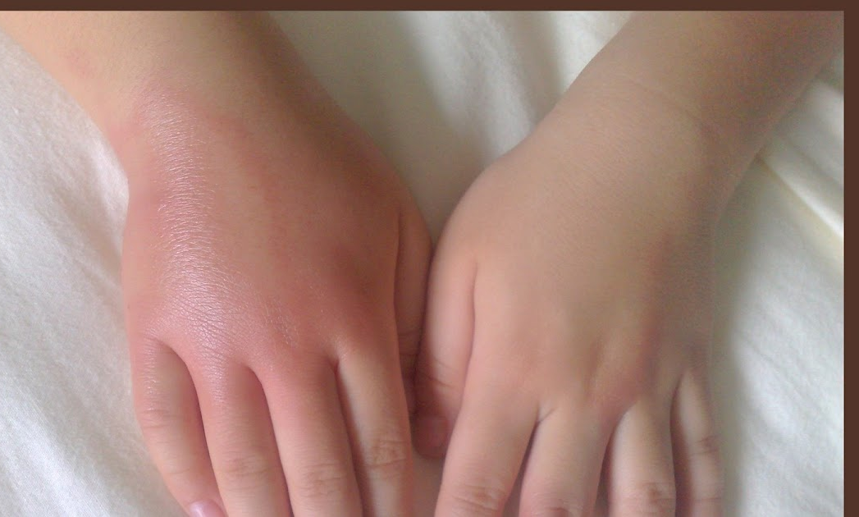

Go to emergency TODAY if you have any of these symptoms
Severe swelling
Swelling, pain, warmth, or redness in your leg or arm, especially on one side, can be a sign of a blood clot
Blood clots can travel into your lungs or your brain, causing a stroke or difficulty breathing
Sudden, severe swelling in your hands or face can be a sign of pre-eclampsia
MORE SYMPTOMS
Notes:
Info source:
Urgent Maternal Warning Signs | AIM (saferbirth.org)
Image source:
https://www.flickr.com/photos/emmajane/45359115
http://babieslz.blogspot.com/2009/05/swollen-hand.html

Slide 20



Go to emergency TODAY if you have any of these symptoms
Changes in vision
Unusual vision such as flashes of light, areas that you can’t see, blurry vision, or double vision
This could be a sign of pre-eclampsia or stroke – thickened blood that blocks nutrients from entering your brain
MORE SYMPTOMS
Notes:
Info source:
Urgent Maternal Warning Signs | AIM (saferbirth.org)
Image source:
http://flickr.com/photos/nayukim/3826871881
https://www.geograph.org.uk/photo/7658579
Labrador Retriever Dog Pet Tongue - Free photo on Pixabay - Pixabay

Slide 21

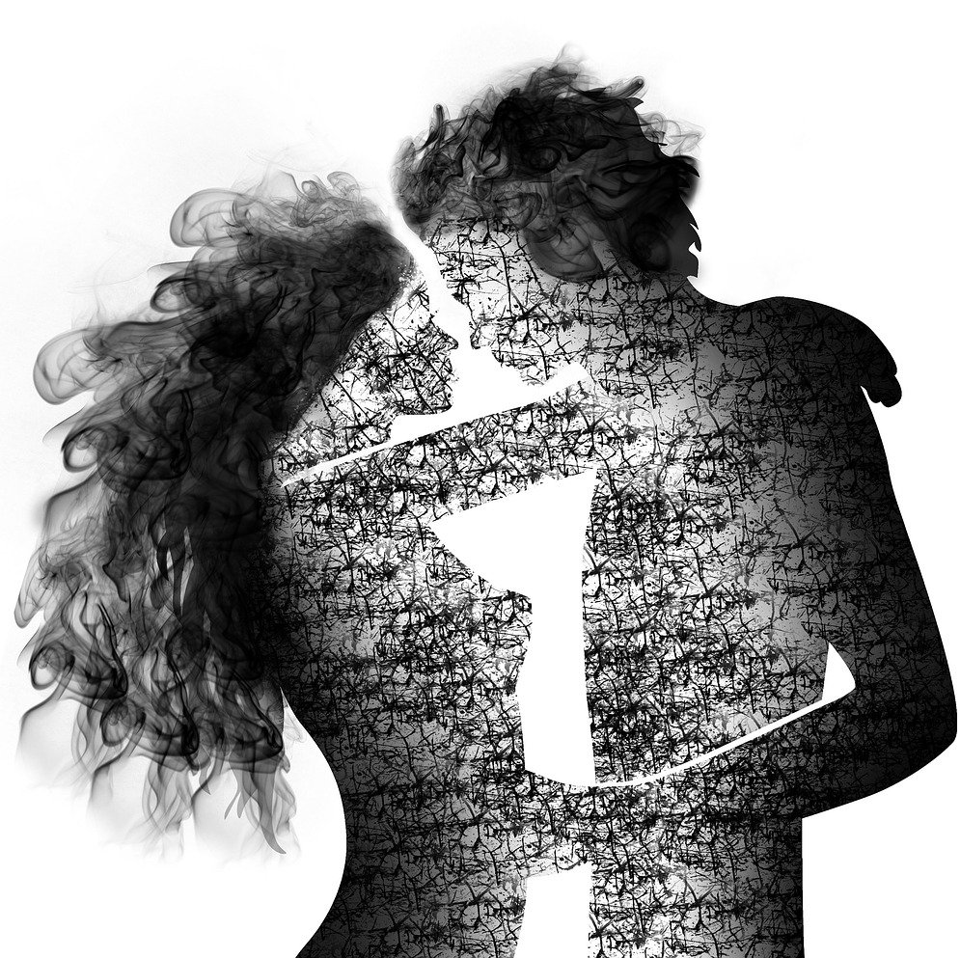
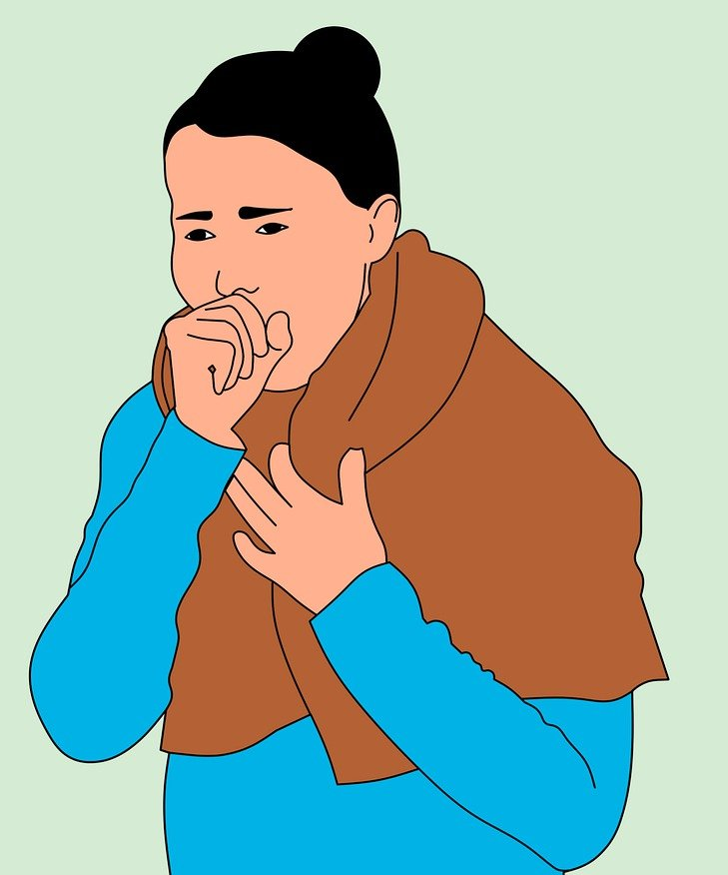
Go to a health center to check for and manage these conditions
Anemia
Alcohol use
Pre-eclampsia
Diabetes
HIV and syphilis
Tuberculosis
Notes:
Image source:
Download Beer Bottle Heineken2 Royalty-Free Stock Illustration Image – Pixabay
Download Sex Love Embrace Royalty-Free Stock Illustration Image – Pixabay
Download Cough Disease Cold Royalty-Free Stock Illustration Image - Pixabay

Slide 22
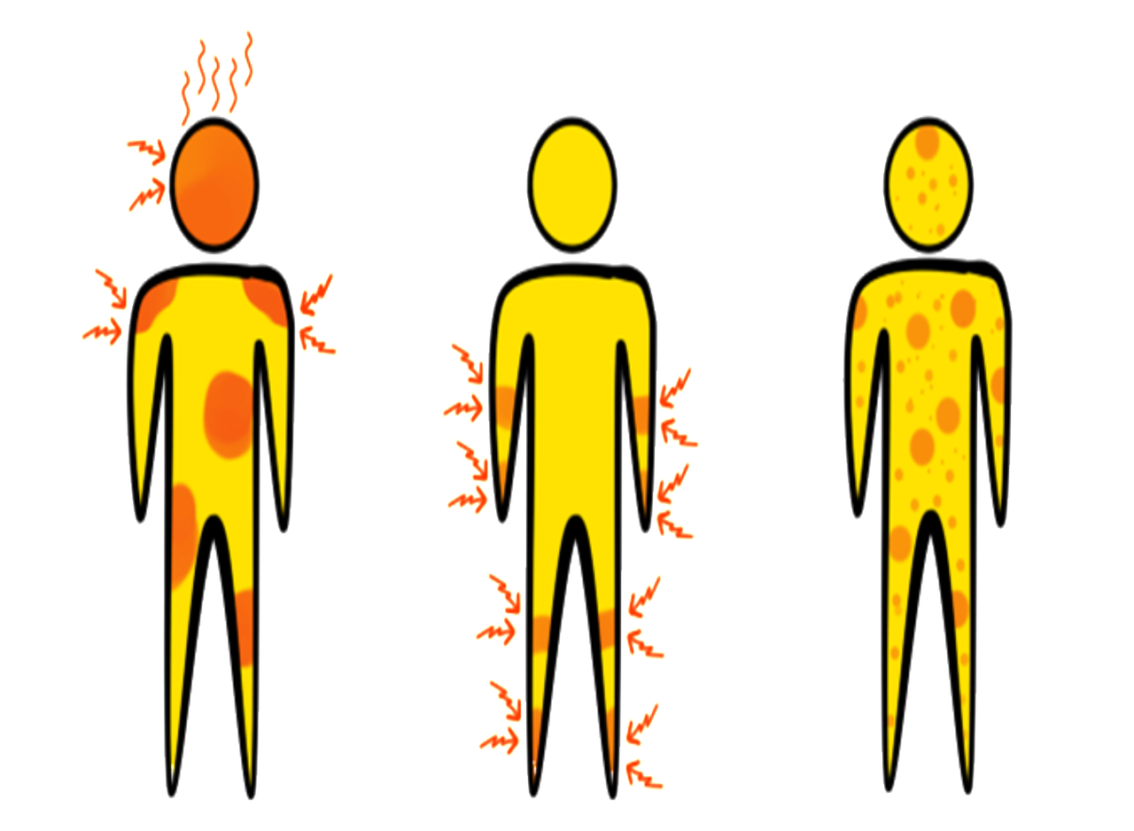
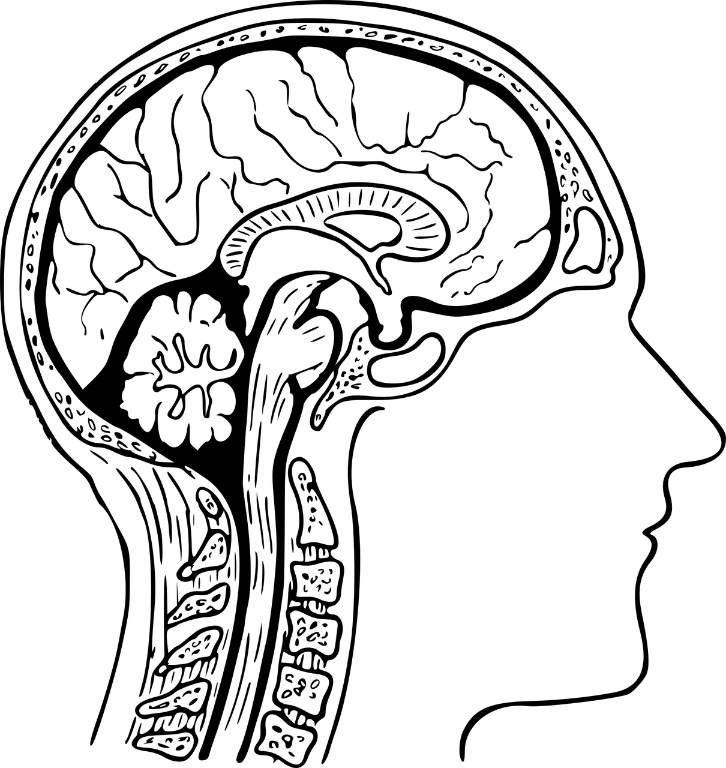
Go to a health center to check for and manage these conditions
Anemia
A person with anemia does not have enough red cells in her blood. Red blood cells transport oxygen from our lungs to the rest of our body.
If our body does not get enough oxygen, it cannot work properly. Our cells will start to die.
Symptoms
Treatment
Science
Notes:
Image source
Download Anatomy, Brain, Cross-Section. Royalty-Free Vector Graphic – Pixabay
Download Symptoms Aedes Aegypti Disease Royalty-Free Stock Illustration Image - Pixabay

Slide 23



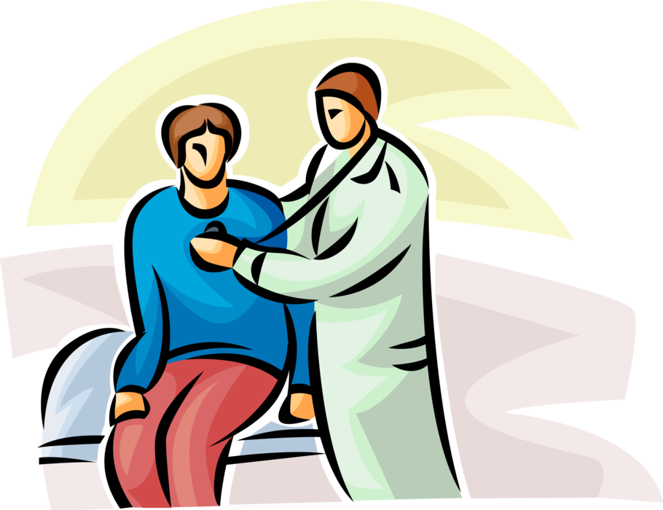
Symptoms
Anemia
Feeling weak and tired
Dizzy
Pale or yellow skin
Chest pain
Cold hands and feet
Hard to breathe
Fast or irregular heartbeat
Other
conditions
Treatment
Science
Notes:
Image source
Download Anatomy, Brain, Cross-Section. Royalty-Free Vector Graphic – Pixabay
Download Symptoms Aedes Aegypti Disease Royalty-Free Stock Illustration Image – Pixabay
https://images.app.goo.gl/QtZgMBHsgfprrJd28
https://images.app.goo.gl/iPLisDgdBsEK5t9o8
https://images.app.goo.gl/W8i9nF4ouA3GPRJTA

Slide 24

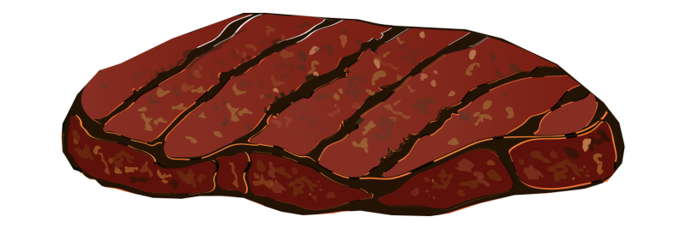
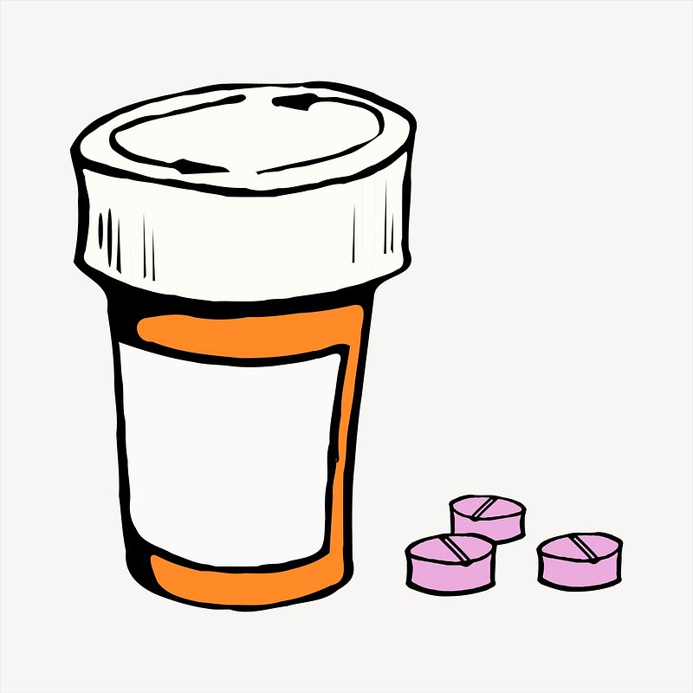
Treatment
Anemia
Mild anemia can be treated by eating foods with iron, like meat and dark green vegetables.
Severe anemia can be treated with iron and vitamin pills, blood transfusions, and other medical treatments.
Other
conditions
Symptoms
Science
Notes:
Image source
Download Anatomy, Brain, Cross-Section. Royalty-Free Vector Graphic – Pixabay
Download Symptoms Aedes Aegypti Disease Royalty-Free Stock Illustration Image – Pixabay
https://images.app.goo.gl/fU3vLUCS4C3dVx4y7
https://images.app.goo.gl/Fpr7dy3z2XrABomd9
https://images.app.goo.gl/sEx888LejU5NTua89

Slide 25
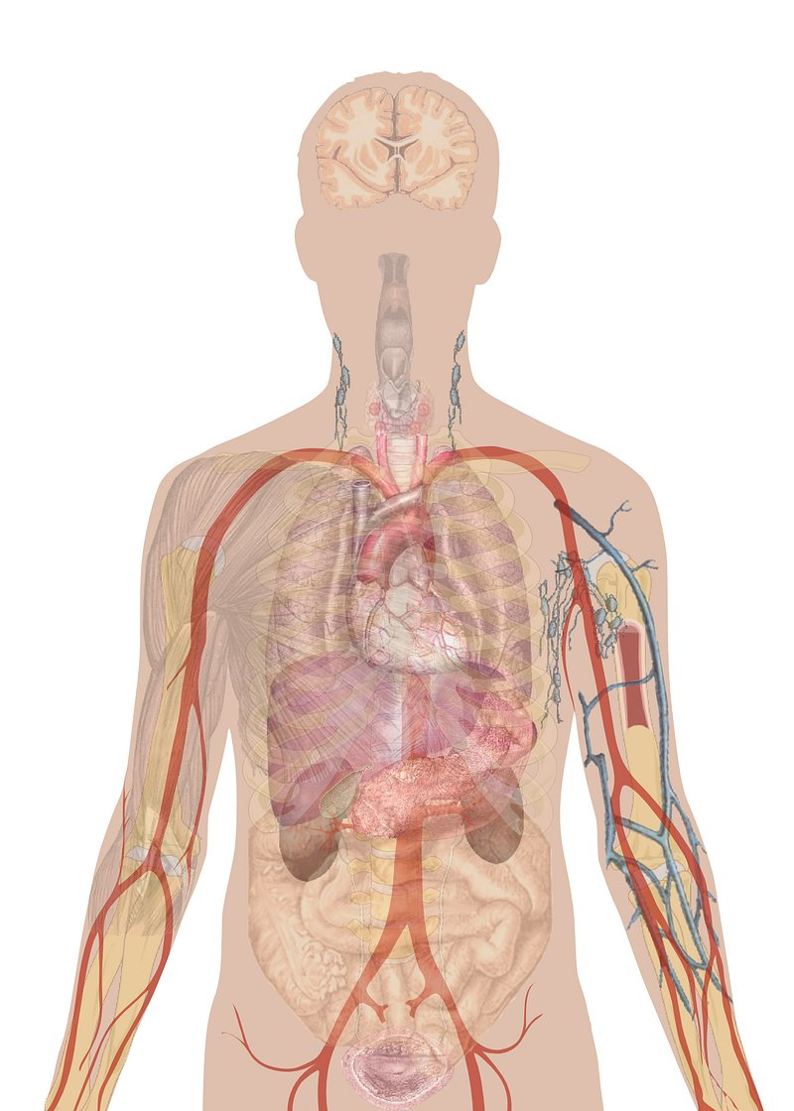
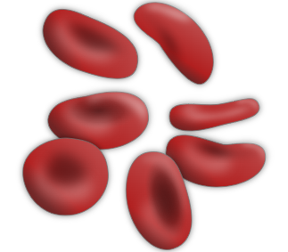

Science
Anemia
We breathe oxygen from the air, and it is brought to every part of our body by red blood cells, like trucks transporting water through the country.
Without oxygen, our cells cannot do their work and we will become weak, and our baby cannot grow well.
Other
conditions
Symptoms
Treatment
Notes:
Image source
Download Anatomy, Brain, Cross-Section. Royalty-Free Vector Graphic – Pixabay
Download Symptoms Aedes Aegypti Disease Royalty-Free Stock Illustration Image – Pixabay
https://images.app.goo.gl/L5WYv2qvVkkL6T4C8
https://images.app.goo.gl/npMxoEu2tYzywGZF6
https://images.app.goo.gl/APRMr2F1ciC4pm779
https://images.app.goo.gl/d99QqeereHtD9o9U6

Slide 26


Go to a health center to check for and manage these conditions
Alcohol Use
If you drink alcohol during pregnancy, like beer, chicha, or cane liquor, it can affect how your baby develops.
Your baby could be born with fetal alcohol syndrome: for its whole life, it could have trouble with learning and making decisions.
Symptoms
Treatment
Science
Notes:
Image source
Download Anatomy, Brain, Cross-Section. Royalty-Free Vector Graphic – Pixabay
Download Symptoms Aedes Aegypti Disease Royalty-Free Stock Illustration Image – Pixabay
https://images.app.goo.gl/pd7WCCZRHfGQ1aJt8
https://images.app.goo.gl/ytR2rKNGvF1Atjkx5
https://images.app.goo.gl/kj1t7rbU5idXyszw9

Slide 27
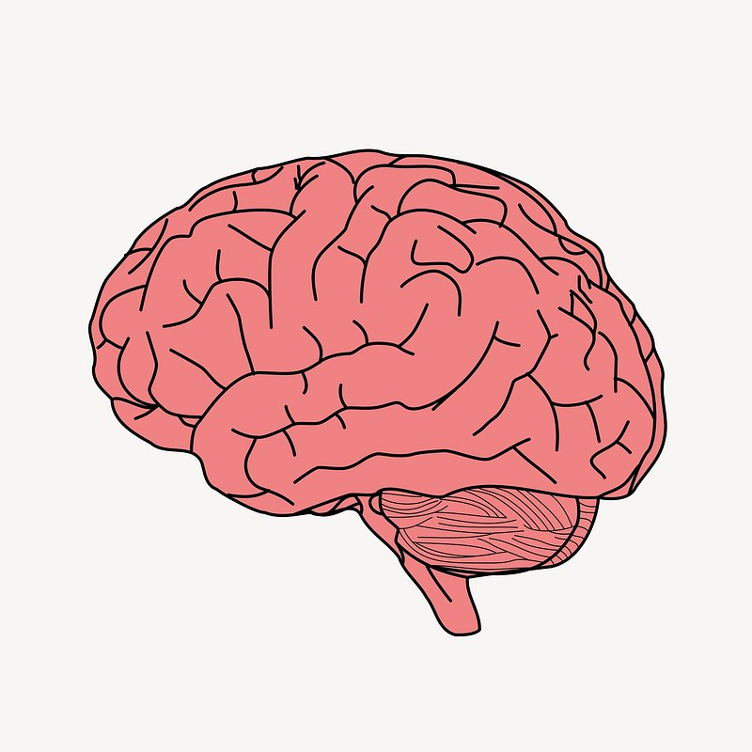
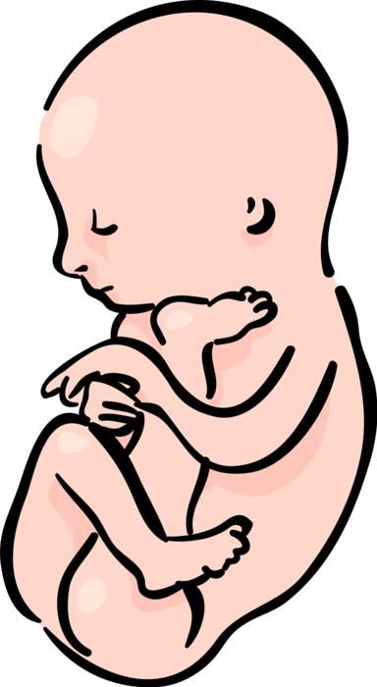
Symptoms
Alcohol Use
The child might be:
Uncoordinated
Grow slowly
Difficulty learning
and paying attention
Poor memory
Learns to speak late
Other
conditions
Treatment
Science
Notes:
Image source
Download Anatomy, Brain, Cross-Section. Royalty-Free Vector Graphic – Pixabay
Download Symptoms Aedes Aegypti Disease Royalty-Free Stock Illustration Image – Pixabay
https://images.app.goo.gl/CqCAVaUS7XwhwjTD6
https://images.app.goo.gl/RbfFJbEHrLwvgLL79

Slide 28

Treatment
Alcohol Use
There is no treatment for a baby with fetal alcohol syndrome, because its brain has been changed; it is best to prevent it by never drinking while pregnant.
The parents can support their child and teach it, but the effects will be for their whole life.
Some children might be affected just a little, and others might be disabled.
Other
conditions
Symptoms
Science
Notes:
Image source
Download Anatomy, Brain, Cross-Section. Royalty-Free Vector Graphic – Pixabay
Download Symptoms Aedes Aegypti Disease Royalty-Free Stock Illustration Image – Pixabay
https://images.app.goo.gl/6eTcUL6uqSMWPYDq6

Slide 29
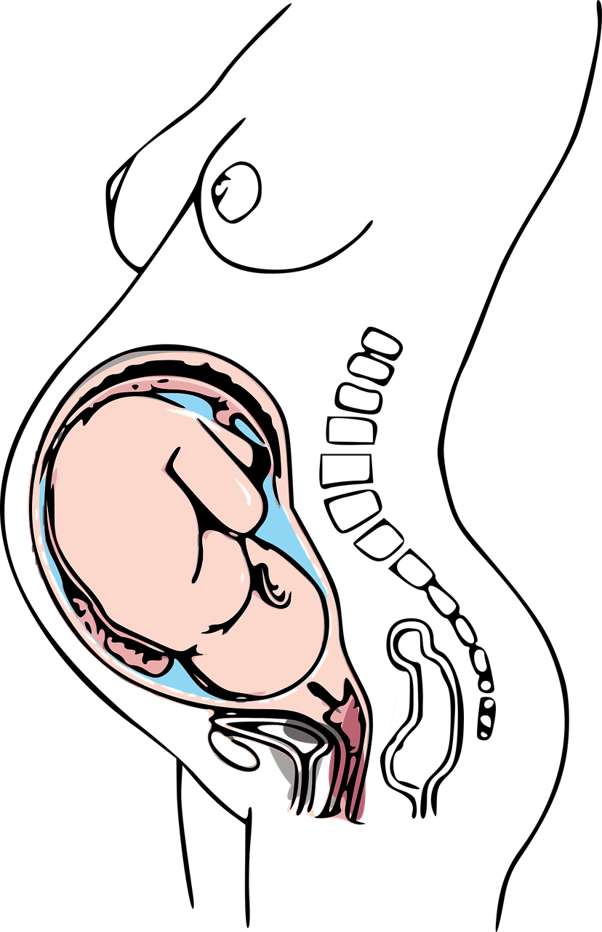
Science
Alcohol Use
When you drink alcohol, it enters your blood and then enters the baby.
It is like a poison for the baby and disrupts its normal development.
Even a small amount can hurt your baby, especially in the early months of pregnancy.
Other
conditions
Symptoms
Treatment
Notes:
Image source
Download Anatomy, Brain, Cross-Section. Royalty-Free Vector Graphic – Pixabay
Download Symptoms Aedes Aegypti Disease Royalty-Free Stock Illustration Image – Pixabay
https://images.app.goo.gl/opJHri5y7ktoozX89
https://images.app.goo.gl/TEwVnHW4oeNK1e6h7

Slide 30
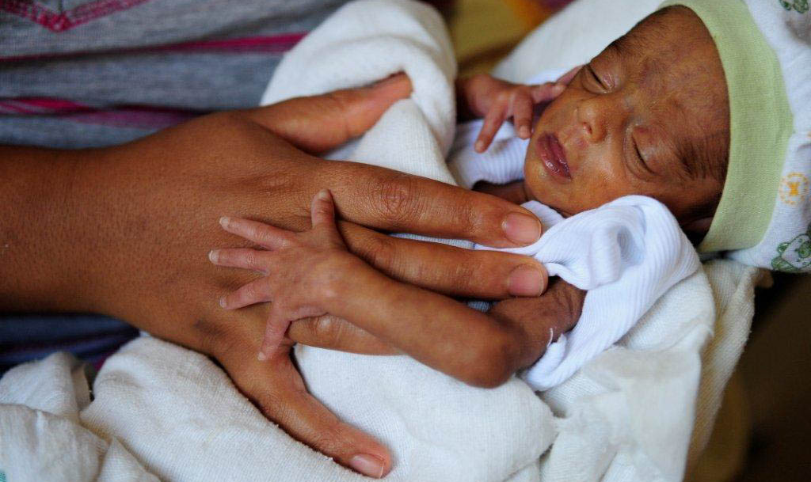
Go to a health center to check for and manage these conditions
Pre-eclampsia
A person with pre-eclampsia has high blood pressure and swelling, especially during the second half of pregnancy.
This can affect the growth of the baby, and it will not grow as much as it should.
Symptoms
Treatment
Science
Notes:
Image source
Download Anatomy, Brain, Cross-Section. Royalty-Free Vector Graphic – Pixabay
Download Symptoms Aedes Aegypti Disease Royalty-Free Stock Illustration Image – Pixabay
https://images.app.goo.gl/HqyVpoX8ZVv3NVyn7

Slide 31
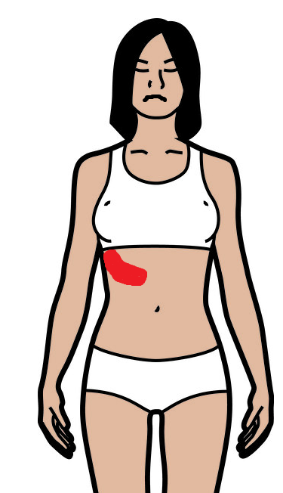
Symptoms
Pre-eclampsia
Nausea Vomiting
Severe headaches Changes in vision
Pain under the ribs Hard to breathe on the right side
Other
conditions
Treatment
Science
Notes:
Image source
Download Anatomy, Brain, Cross-Section. Royalty-Free Vector Graphic – Pixabay
Download Symptoms Aedes Aegypti Disease Royalty-Free Stock Illustration Image – Pixabay
https://images.app.goo.gl/MdRXem7uj6MACdPC9

Slide 32
Treatment
Pre-eclampsia
Some treatments are:
Bed rest
Drink water and eat less salt
Medication to lower blood pressure and reduce risk of seizures
Once a woman develops pre-eclampsia, she will have it until she gives birth. It is very important to be monitored by a doctor and give birth in the hospital.
Other
conditions
Symptoms
Science
Notes:
Image source
Download Anatomy, Brain, Cross-Section. Royalty-Free Vector Graphic – Pixabay
Download Symptoms Aedes Aegypti Disease Royalty-Free Stock Illustration Image - Pixabay

Slide 33
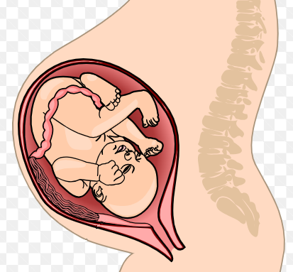
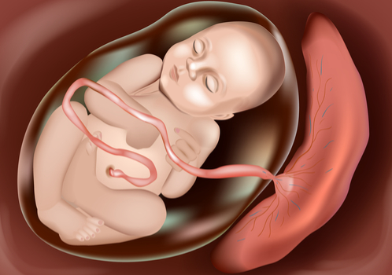
Science
Pre-eclampsia
The high pressure can squeeze the vessels that carry blood from the mother to the baby.
Everything that the baby needs to grow is transported in blood, so if the blood cannot get through the vessels, then the baby cannot grow well.
Other
conditions
Symptoms
Treatment
Notes:
Image source
Download Anatomy, Brain, Cross-Section. Royalty-Free Vector Graphic – Pixabay
Download Symptoms Aedes Aegypti Disease Royalty-Free Stock Illustration Image – Pixabay
https://images.app.goo.gl/u7f497KEwsrSUUH26
https://images.app.goo.gl/Vao3ukC6jdYtEFKb6

Slide 34

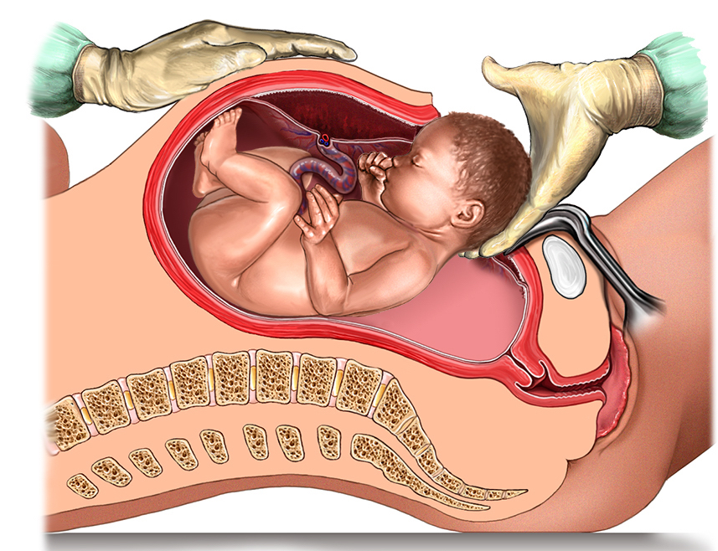
Go to a health center to check for and manage these conditions
Diabetes
This can cause the baby to grow too large, and you might need a Cesarean section.
A person with diabetes has too much sugar in their blood.
Women can develop diabetes during pregnancy.
Symptoms
Treatment
Science
Notes:
Image source
Download Anatomy, Brain, Cross-Section. Royalty-Free Vector Graphic – Pixabay
Download Symptoms Aedes Aegypti Disease Royalty-Free Stock Illustration Image – Pixabay
https://images.app.goo.gl/JWAvXpjcoXwnkFLe9
https://images.app.goo.gl/byof1rGLKyJhn8B76

Slide 35



Symptoms
Diabetes
Urinating frequently Often thirsty
The urine has a sweet smell
Nausea Often tired
Other
conditions
Treatment
Science
Notes:
Image source
Download Anatomy, Brain, Cross-Section. Royalty-Free Vector Graphic – Pixabay
Download Symptoms Aedes Aegypti Disease Royalty-Free Stock Illustration Image – Pixabay
https://images.app.goo.gl/6obihzM1p5zABAds9
https://images.app.goo.gl/x9W7YHutfFi2xabeA
https://images.app.goo.gl/f5NYigXSrR8yZraR7

Slide 36



Treatment
Diabetes
A pregnant woman with diabetes needs to be monitored by a doctor. Sometimes she will receive medication to help the body absorb sugar.
Eat more foods that are low in sugar, like vegetables, beans, eggs, and meat. Eat smaller amounts, more times per day.
Other
conditions
Symptoms
Science
Notes:
Image source
Download Anatomy, Brain, Cross-Section. Royalty-Free Vector Graphic – Pixabay
Download Symptoms Aedes Aegypti Disease Royalty-Free Stock Illustration Image – Pixabay
https://images.app.goo.gl/DtmBRXjduvm5MjVV6
https://images.app.goo.gl/zrc5AQQSremYit5Y8
https://images.app.goo.gl/cREhURopcBj71BnR6
https://images.app.goo.gl/dh37xe9ryMkxH86u9
https://images.app.goo.gl/bhBDW7VRfdK2p2fQ7

Slide 37



Science
Diabetes
When we eat, the sugar from the food enters our cells and is used as fuel. With diabetes, the sugar cannot enter the cells, and stays in the blood.
Foods that are starchy, like rice, corn, and bread, contain sugar. So do sweet foods like fruit or juice.
Other
conditions
Symptoms
Treatment
Notes:
Image source
Download Anatomy, Brain, Cross-Section. Royalty-Free Vector Graphic – Pixabay
Download Symptoms Aedes Aegypti Disease Royalty-Free Stock Illustration Image – Pixabay
https://images.app.goo.gl/JHbjnCyZDan6es5x6
https://images.app.goo.gl/gkoFz9iG6BvHJndE8
https://images.app.goo.gl/jVAnUEpRm5tLQWPQ8

Slide 38

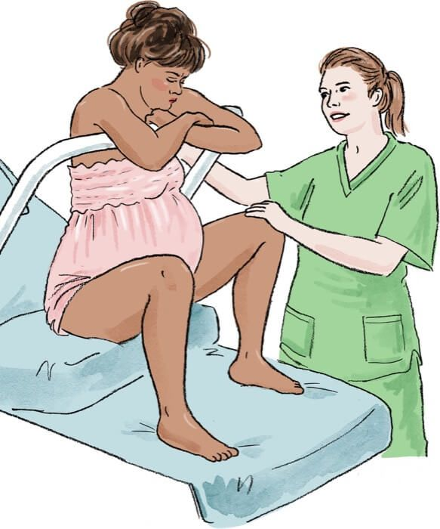
Go to a health center to check for and manage these conditions
HIV and syphilis
HIV and syphilis are transmitted by blood and sexual fluids. If the mother has HIV or syphilis, she can transmit it to the baby during birth.
The child will have HIV for its whole life. Syphilis can be cured, but it can cause serious disability in the baby if it’s not treated in time.
Symptoms
Treatment
Science
Notes:
Image source
Download Anatomy, Brain, Cross-Section. Royalty-Free Vector Graphic – Pixabay
Download Symptoms Aedes Aegypti Disease Royalty-Free Stock Illustration Image – Pixabay
https://images.app.goo.gl/ckfvE5G8eRSmFhsLA
https://images.app.goo.gl/c2T1q2yxCc9Y9k8x9

Slide 39

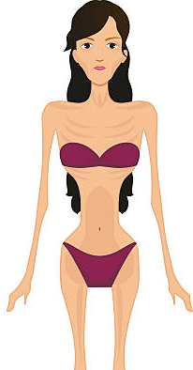
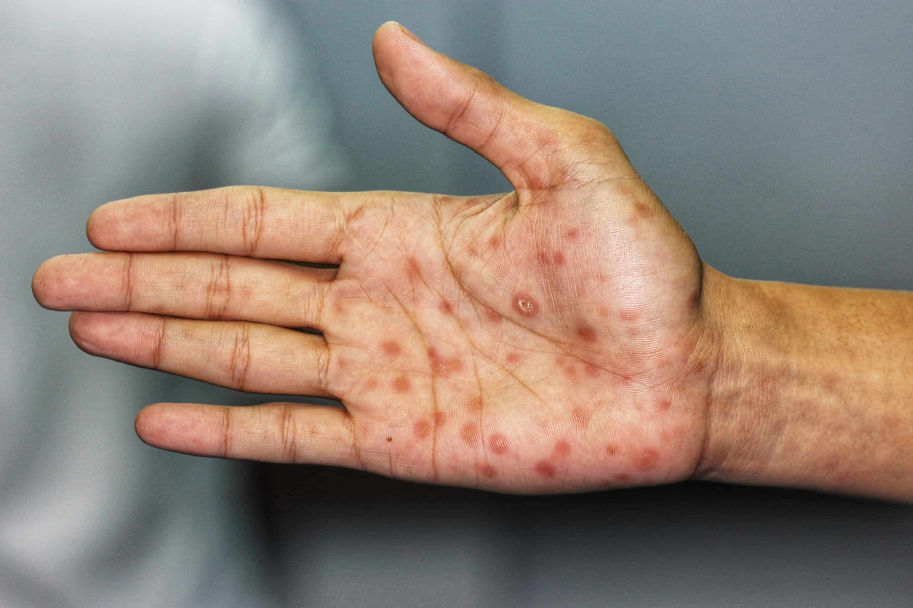
Symptoms
HIV and syphilis
All pregnant women should be tested for HIV and syphilis, because they do not always have symptoms, especially in the early phases. Some symptoms:
Often sick Sweating at night
Weight loss Rashes on hands or feet
Other
conditions
Treatment
Science
Notes:
Image source
Download Anatomy, Brain, Cross-Section. Royalty-Free Vector Graphic – Pixabay
Download Symptoms Aedes Aegypti Disease Royalty-Free Stock Illustration Image – Pixabay
https://images.app.goo.gl/J8G6nMVGpHNB4vKR7
https://images.app.goo.gl/jQWRWwUkq4Lf5Xt58
https://images.app.goo.gl/LMuXV4t5jfDHMwKF8

Slide 40
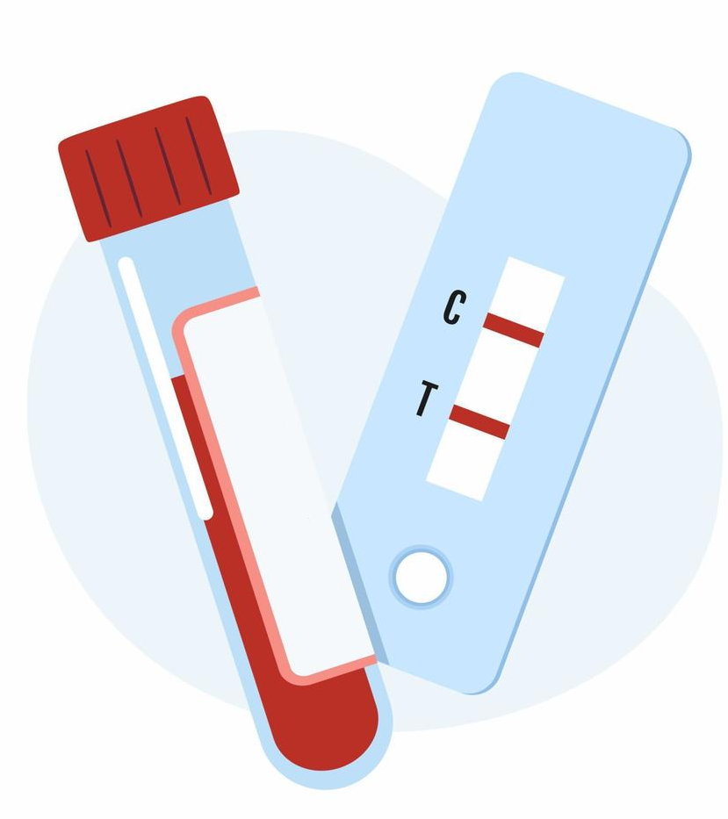

Treatment
HIV and syphilis
HIV and syphilis must be detected by laboratory tests.
Plant medicine cannot treat or cure HIV.
HIV can be controlled well by a daily pill for your whole life. A women getting treatment will not pass HIV to her baby.
Syphilis can be cured.
Other
conditions
Symptoms
Science
Notes:
Image source
Download Anatomy, Brain, Cross-Section. Royalty-Free Vector Graphic – Pixabay
Download Symptoms Aedes Aegypti Disease Royalty-Free Stock Illustration Image – Pixabay
https://images.app.goo.gl/NKxcybaRcH7YCJ8Z7
https://images.app.goo.gl/U3PQXadEw66TUQjK6

Slide 41
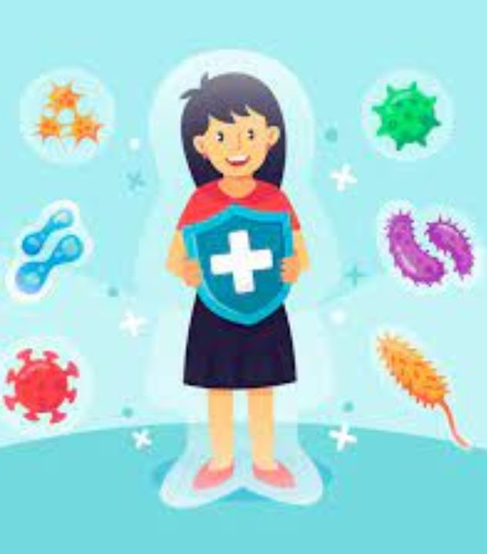
Science
HIV and syphilis
Over a long time, HIV destroys the defense system of your body. Your body becomes weak and can no longer fight off normal illnesses.
Syphilis can travel to your brain and organs and damage them, if it is not treated for a long time.
Other
conditions
Symptoms
Treatment
Notes:
Image source
Download Anatomy, Brain, Cross-Section. Royalty-Free Vector Graphic – Pixabay
Download Symptoms Aedes Aegypti Disease Royalty-Free Stock Illustration Image – Pixabay
https://images.app.goo.gl/TJZm1AzF4gGeCsBk7

Slide 42
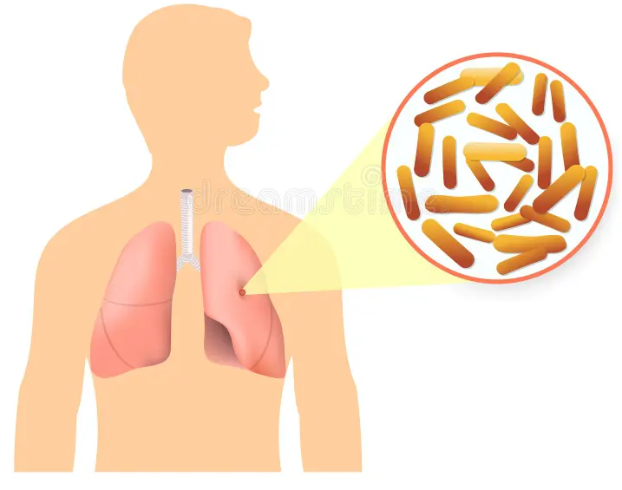
Go to a health center to check for and manage these conditions
Tuberculosis
Tuberculosis is an infection in your lungs. It is spread through the air by coughing. It can be in your body for many years before making you sick.
A woman with tuberculosis is at higher risk for illness during pregnancy and miscarriages.
Symptoms
Treatment
Science
Notes:
Image source
Download Anatomy, Brain, Cross-Section. Royalty-Free Vector Graphic – Pixabay
Download Symptoms Aedes Aegypti Disease Royalty-Free Stock Illustration Image - Pixabay

Slide 43
Symptoms
Tuberculosis
Fever or chills Cough for 3+ weeks
Sweating at night Tired, not hungry
Pain when you breathe Weight loss
Other
conditions
Treatment
Science
Notes:
Image source
Download Anatomy, Brain, Cross-Section. Royalty-Free Vector Graphic – Pixabay
Download Symptoms Aedes Aegypti Disease Royalty-Free Stock Illustration Image - Pixabay

Slide 44

Treatment
Tuberculosis
Tuberculosis is curable. It needs to be treated by a doctor.
The treatment takes 6 to 12 months and must be followed to the end, even if you feel better.
Pregnant women can get treatment.
Other
conditions
Symptoms
Science
Notes:
Image source
Download Anatomy, Brain, Cross-Section. Royalty-Free Vector Graphic – Pixabay
Download Symptoms Aedes Aegypti Disease Royalty-Free Stock Illustration Image - Pixabay

Slide 45
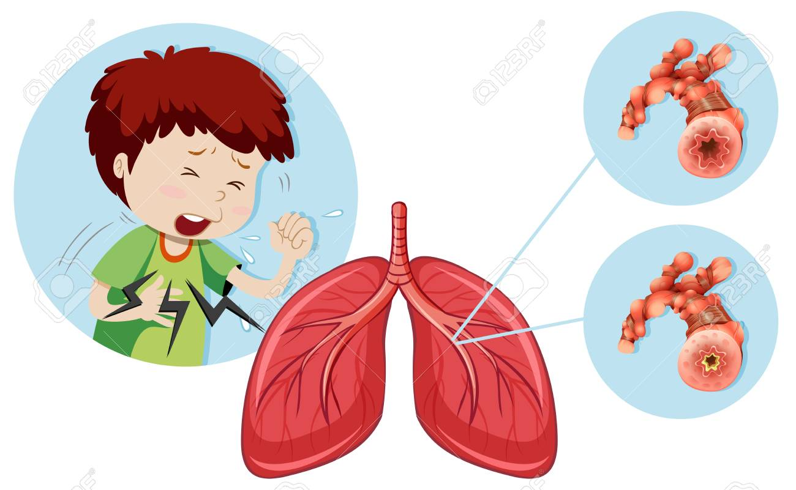
Science
Tuberculosis
Tuberculosis is a bacteria that lives in the lungs. When it starts to reproduce, it damages your lungs and makes it difficult to breathe.
Other
conditions
Symptoms
Treatment
Notes:
Image source
Download Anatomy, Brain, Cross-Section. Royalty-Free Vector Graphic – Pixabay
Download Symptoms Aedes Aegypti Disease Royalty-Free Stock Illustration Image – Pixabay
https://images.app.goo.gl/74nSAM8fFwhAM1dy9

Slide 46
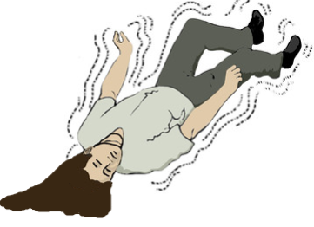
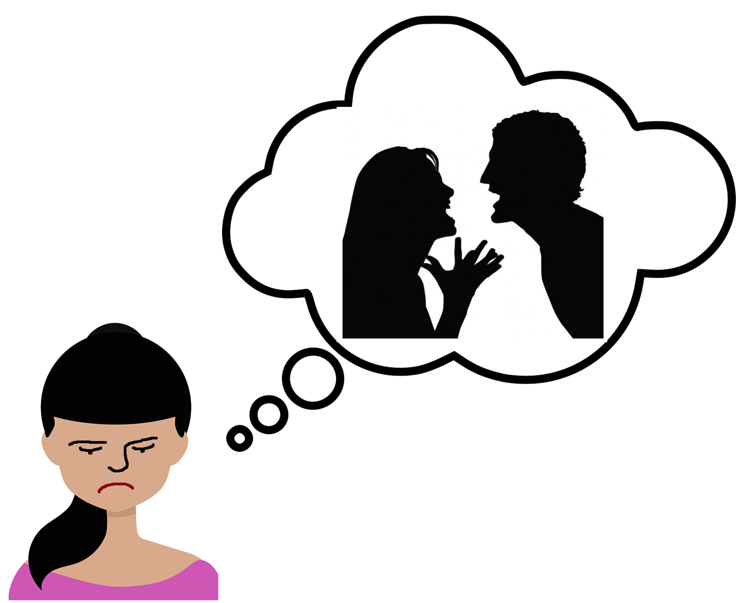
Go to emergency TODAY if you have any of these symptoms
Trouble breathing
Chest pain
Seizures
Violent thoughts
MORE SYMPTOMS
Notes:
Pop up boxes appear if any of the images are clicked
Info source:
Postpartum complications: What you need to know - Mayo Clinic
11.4 Postpartum complications | MSF Medical Guidelines
Image source:
http://flickr.com/photos/pnash/6985860365
https://philosophicaldisquisitions.blogspot.com/2010/08/oppy-on-disagreement-part-3.html
Download Speech Bubble, Thought, Cloud. Royalty-Free Vector Graphic – Pixabay
Download Avatar Clients Customers Royalty-Free Stock Illustration Image - Pixabay

Slide 47
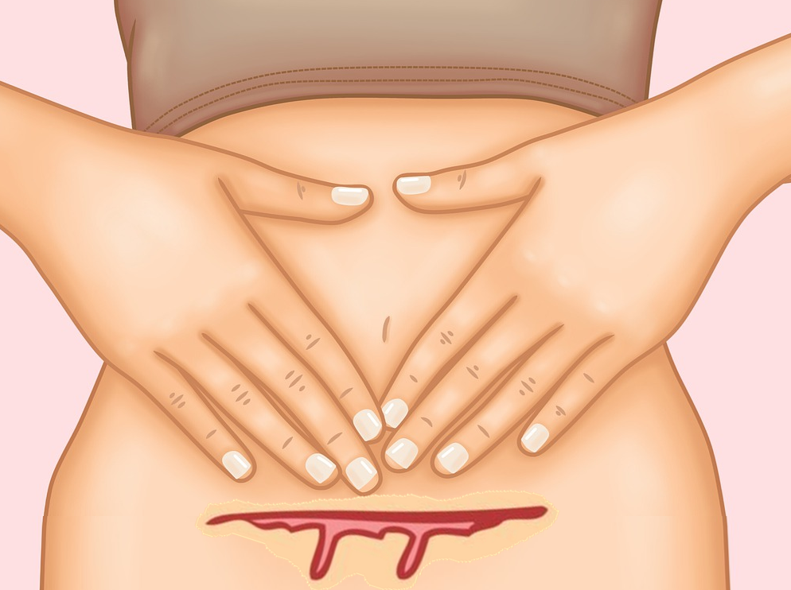
Go to the clinic this week if you have any of these symptoms
Excess vaginal bleeding
Foul-smelling vaginal discharge
Red and swollen leg
Fever
Incision won’t heal
Severe headache
Notes:
Pop up boxes appear if any of the images are clicked
Info source:
Postpartum complications: What you need to know - Mayo Clinic
11.4 Postpartum complications | MSF Medical Guidelines
Image source:
http://prettycureallstarsdx.forosactivos.net/t265p75-kimokakkoi-pretty-cure
Download Stomach Body Little Girl Royalty-Free Stock Illustration Image - Pixabay

Slide 48
Go to emergency TODAY if you have any of these symptoms postpartum
Trouble breathing
You can’t get enough air when you breathe, or your chest or throat is tight, or you can’t breathe when you’re lying down
Watch out for: swelling, chest pain, headache, dizziness, changes in vision, or a fast heartbeat
This could be a sign of eclampsia: a medical emergency
MORE SYMPTOMS
Notes:
Info source:
Urgent Maternal Warning Signs | AIM (saferbirth.org)
Image source:
Download Bed, Hospital, Medical. Royalty-Free Vector Graphic – Pixabay

Slide 49
Go to emergency TODAY if you have any of these symptoms postpartum
Chest pain
Any symptom like fast or irregular heartbeat, pain that moves to your arm or neck, tightness in chest,
Watch out for: sudden onset, swelling, dizziness or confusion, trouble breathing, headache.
This could be a sign of heart attack or a blockage in your lungs
MORE SYMPTOMS
Notes:
Info source:
Urgent Maternal Warning Signs | AIM (saferbirth.org)
Image source:
Download Anatomical, Healthcare, Heart. Royalty-Free Vector Graphic – Pixabay
Download Anatomy, Lungs, Breathing. Royalty-Free Vector Graphic - Pixabay

Slide 50
Go to emergency TODAY if you have any of these symptoms postpartum
Seizures
You suddenly lose consciousness and have a seizure – your body becomes stiff and shakes and convulses.
This could be a sign of eclampsia: a medical emergency
MORE SYMPTOMS
Notes:
Info source:
Urgent Maternal Warning Signs | AIM (saferbirth.org)

Slide 51
Go to emergency TODAY if you have any of these symptoms postpartum
Violent thoughts
You have unusual thoughts about hurting yourself or your baby. You might not feel like yourself.
This could be a sign of
post-partum depression
MORE SYMPTOMS
Notes:
Info source:
Urgent Maternal Warning Signs | AIM (saferbirth.org)

Slide 52
Go to the clinic this week if you have any of these symptoms postpartum
Excess vaginal bleeding
You have bleeding from your vagina after giving birth, like menstruation. It might be a lot of blood or continue for a long time.
You could lose consciousness or even die if you lose too much blood
MORE SYMPTOMS
Notes:
Info source:
Urgent Maternal Warning Signs | AIM (saferbirth.org)

Slide 53
Go to the clinic this week if you have any of these symptoms postpartum
Foul-smelling vaginal discharge
You have unusual discharge from your vagina after giving birth. It might have a strange or bad smell, or it might be green or yellow.
This could be a sign of infection inside of your body
MORE SYMPTOMS
Notes:
Info source:
Urgent Maternal Warning Signs | AIM (saferbirth.org)

Slide 54
Go to the clinic this week if you have any of these symptoms postpartum
Red and swollen leg
Swelling, pain, warmth, or redness in your leg or arm, especially on one side, can be a sign of a blood clot
Blood clots can travel into your lungs or your brain, causing a stroke or difficulty breathing
Sudden, severe swelling in your hands or face can be a sign of eclampsia: a medical emergency
MORE SYMPTOMS
Notes:
Info source:
Urgent Maternal Warning Signs | AIM (saferbirth.org)
Image source:
https://www.flickr.com/photos/emmajane/45359115
http://babieslz.blogspot.com/2009/05/swollen-hand.html

Slide 55
Go to the clinic this week if you have any of these symptoms postpartum
Fever
Temperature of 38°C or higher
Watch out for: diarrhea, vomiting, pain, discharge, or trouble urinating
This could be a sign of infection inside of your body
MORE SYMPTOMS
Notes:
Info source:
Urgent Maternal Warning Signs | AIM (saferbirth.org)
Image source:
Download Belly Stomach Pain Pains Royalty-Free Stock Illustration Image – Pixabay
Thermometer Fever Number - Free photo on Pixabay - Pixabay

Slide 56
Go to the clinic this week if you have any of these symptoms postpartum
Incision won’t heal
If you had a Cesarean section, make sure the wound is healing well: there is no redness, heat, swelling, or odor.
If it is not healing, you might need antibiotics to treat an infection.
An open wound could put you at risk to get an infection
MORE SYMPTOMS
Notes:
Info source:
Urgent Maternal Warning Signs | AIM (saferbirth.org)

Slide 57
Go to the clinic this week if you have any of these symptoms postpartum
Severe headache
A headache that started suddenly, is throbbing and above your ear, and will not go away
Watch out for: dizziness, swelling, or changed vision
This could be a sign of eclampsia: a medical emergency
MORE SYMPTOMS
Notes:
Info source:
Urgent Maternal Warning Signs | AIM (saferbirth.org)
Image source:
Download Blood Pressure Measuring Machine, Blood Pressure, Health. Royalty-Free Vector Graphic - Pixabay

Slide 58
Go to emergency TODAY if you might have any of these conditions
Internal infection
Eclampsia
Post-partum depression
Notes:
Image source

Slide 59
Go to a health center to check for and manage these conditions
Eclampsia
Eclampsia is a very dangerous condition that quickly causes seizures, coma, or death. It usually happens in the 2 days after giving birth.
Women that have pre-eclampsia during pregnancy are at higher risk. They should give birth in a hospital.
Symptoms
Treatment
Science
Notes:
Info source:
Eclampsia > Fact Sheets > Yale Medicine
Image source
Download Anatomy, Brain, Cross-Section. Royalty-Free Vector Graphic – Pixabay
Download Symptoms Aedes Aegypti Disease Royalty-Free Stock Illustration Image - Pixabay

Slide 60
Symptoms
Eclampsia
Seizures Pain under the right ribs
Severe headaches Changes in vision
Nausea/Vomiting Hard to breathe
Other
conditions
Treatment
Science
Notes:
Info source:
Eclampsia > Fact Sheets > Yale Medicine
Image source
Download Anatomy, Brain, Cross-Section. Royalty-Free Vector Graphic – Pixabay
Download Symptoms Aedes Aegypti Disease Royalty-Free Stock Illustration Image - Pixabay

Slide 61
Treatment
Eclampsia
Eclampsia is a medical emergency.
It needs to be treated in the hospital immediately.
Other
conditions
Symptoms
Science
Notes:
Info source:
Eclampsia > Fact Sheets > Yale Medicine
Image source
Download Anatomy, Brain, Cross-Section. Royalty-Free Vector Graphic – Pixabay
Download Symptoms Aedes Aegypti Disease Royalty-Free Stock Illustration Image - Pixabay

Slide 62

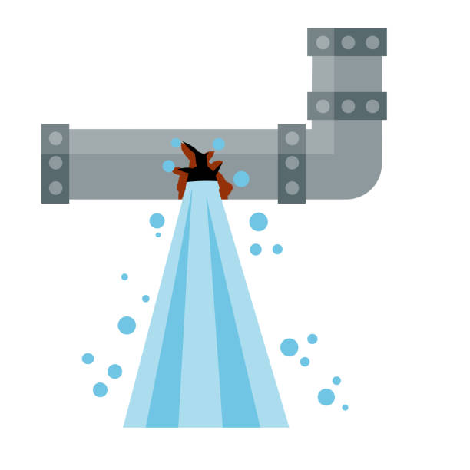
Science
Eclampsia
Your brain needs a lot of blood. Blood brings it fuel so that it can control your body and keep you alive.
When a pregnant woman has high blood pressure, it’s harder for enough blood to reach her brain, like water trying to flow through a small tube.
Other
conditions
Symptoms
Treatment
Notes:
Info source:
Eclampsia > Fact Sheets > Yale Medicine
Image source
Download Anatomy, Brain, Cross-Section. Royalty-Free Vector Graphic – Pixabay
Download Symptoms Aedes Aegypti Disease Royalty-Free Stock Illustration Image – Pixabay
https://images.app.goo.gl/Qm7zs5okubHYp92E6
https://images.app.goo.gl/VKxow5skDNi486mj6

Slide 63
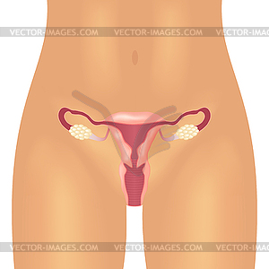

Go to a health center to check for and manage these conditions
Internal Infection
Bacteria can enter a woman’s womb during birth and grow there, causing an infection.
Because the infection is inside of her body, it can easily reach the blood, which carries it to other parts of the body.
Symptoms
Treatment
Science
Notes:
Image source
Download Anatomy, Brain, Cross-Section. Royalty-Free Vector Graphic – Pixabay
Download Symptoms Aedes Aegypti Disease Royalty-Free Stock Illustration Image – Pixabay
https://images.app.goo.gl/G5oBBAqbZf3fjZDw6
https://images.app.goo.gl/k6vXBC7vAavig1Ad9

Slide 64
Symptoms
Internal Infection
Pain in the lower stomach
Fever
Discharge with a bad smell or strange color
Other
conditions
Treatment
Science
Notes:
Image source
Download Anatomy, Brain, Cross-Section. Royalty-Free Vector Graphic – Pixabay
Download Symptoms Aedes Aegypti Disease Royalty-Free Stock Illustration Image - Pixabay

Slide 65

Treatment
Internal Infection
Many infections can be prevented by giving birth in a clean environment and using sterilized tools.
Infections need to be treated with antibiotics, which kill the bacteria. Finish the pills even if you feel better, or the bacteria can grow back.
Other
conditions
Symptoms
Science
Notes:
Image source
Download Anatomy, Brain, Cross-Section. Royalty-Free Vector Graphic – Pixabay
Download Symptoms Aedes Aegypti Disease Royalty-Free Stock Illustration Image – Pixabay
https://images.app.goo.gl/qB4phiRxBBofdJWaA

Slide 66



Science
Internal Infection
Bacteria are like tiny animals that can grow inside of our body and on our skin.
There are many types of bacteria. Some are harmless; some cause diarrhea when they get into our food and water; some cause other illnesses.
Our body has many defenses to get rid of bacteria: coughing, fever, vomiting, diarrhea.
Other
conditions
Symptoms
Treatment
Notes:
Image source
Download Anatomy, Brain, Cross-Section. Royalty-Free Vector Graphic – Pixabay
Download Symptoms Aedes Aegypti Disease Royalty-Free Stock Illustration Image – Pixabay
https://images.app.goo.gl/uyZZSovfGsjXCYz1A
https://images.app.goo.gl/Y43KgAmNSJ4qHVpV9
https://images.app.goo.gl/MEDfz1v7jx1LjUhX8

Slide 67
Go to a health center to check for and manage these conditions
Post-partum depression
After birth, some women become very sad, anxious, and tired. It can become severe and last for a long time.
This is a medical condition; it is not a weakness or because of the woman’s personality.
Symptoms
Treatment
Science
Notes:
Image source
Download Anatomy, Brain, Cross-Section. Royalty-Free Vector Graphic – Pixabay
Download Symptoms Aedes Aegypti Disease Royalty-Free Stock Illustration Image - Pixabay

Slide 68




Thinks about hurting herself or her baby, doesn’t feel connected to her baby
Crying, trouble sleeping, can’t do daily tasks
Bad memory or hard to pay attention
Symptoms
Post-partum depression
Other
conditions
Treatment
Science
Notes:
Image source
Download Anatomy, Brain, Cross-Section. Royalty-Free Vector Graphic – Pixabay
Download Symptoms Aedes Aegypti Disease Royalty-Free Stock Illustration Image – Pixabay
https://images.app.goo.gl/dd92KfUY6QNSfdYd9
https://images.app.goo.gl/W1aHHahAEKARLZcG6
https://images.app.goo.gl/MfM2ycx9Q8WgfqDc7

Slide 69

Treatment
Post-partum depression
Post-partum depression can be treated with medicine that helps the brain return to its normal moods and thoughts.
Sometimes it is caused by a change in hormones, so it can be treated by hormone pills.
Other
conditions
Symptoms
Science
Notes:
Image source
Download Anatomy, Brain, Cross-Section. Royalty-Free Vector Graphic – Pixabay
Download Symptoms Aedes Aegypti Disease Royalty-Free Stock Illustration Image – Pixabay
https://images.app.goo.gl/9ugaYr8hTnXjkNwc6

Slide 70



Science
Post-partum depression
Hormones are powerful chemicals that our body uses to control many processes.
During pregnancy and after birth, there are many hormones in the body.
Hormones can affect the way that the brain works, and cause depression if they are out of balance.
Other
conditions
Symptoms
Treatment
Notes:
Image source
Download Anatomy, Brain, Cross-Section. Royalty-Free Vector Graphic – Pixabay
Download Symptoms Aedes Aegypti Disease Royalty-Free Stock Illustration Image – Pixabay
https://images.app.goo.gl/YTWC9FzjTc1K5ZoQA
https://images.app.goo.gl/QywXtqSo22CM2RDUA
https://images.app.goo.gl/z72JbLNtAX2ChK5s9

